Slide 1
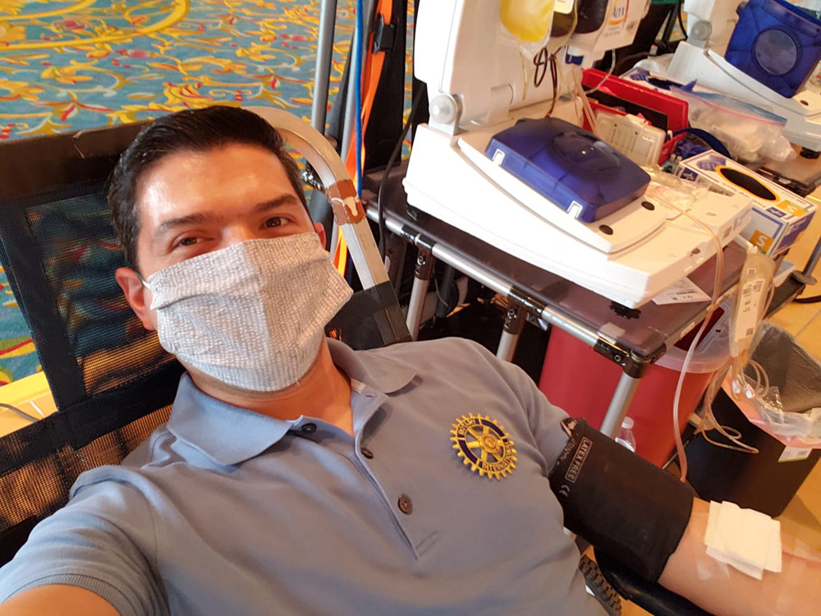

Who is your Target Audience?
Multiplier effect of using Technology
Nancy Paulson
Webmaster, D5930

Slide 2
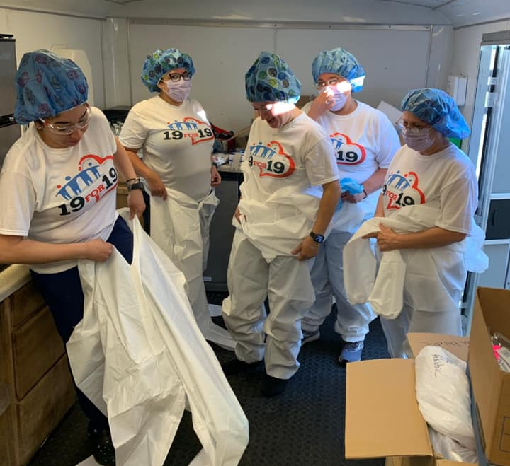
Objectives for today
Member Personas
What Technology?
Storytelling
Resources

Slide 3
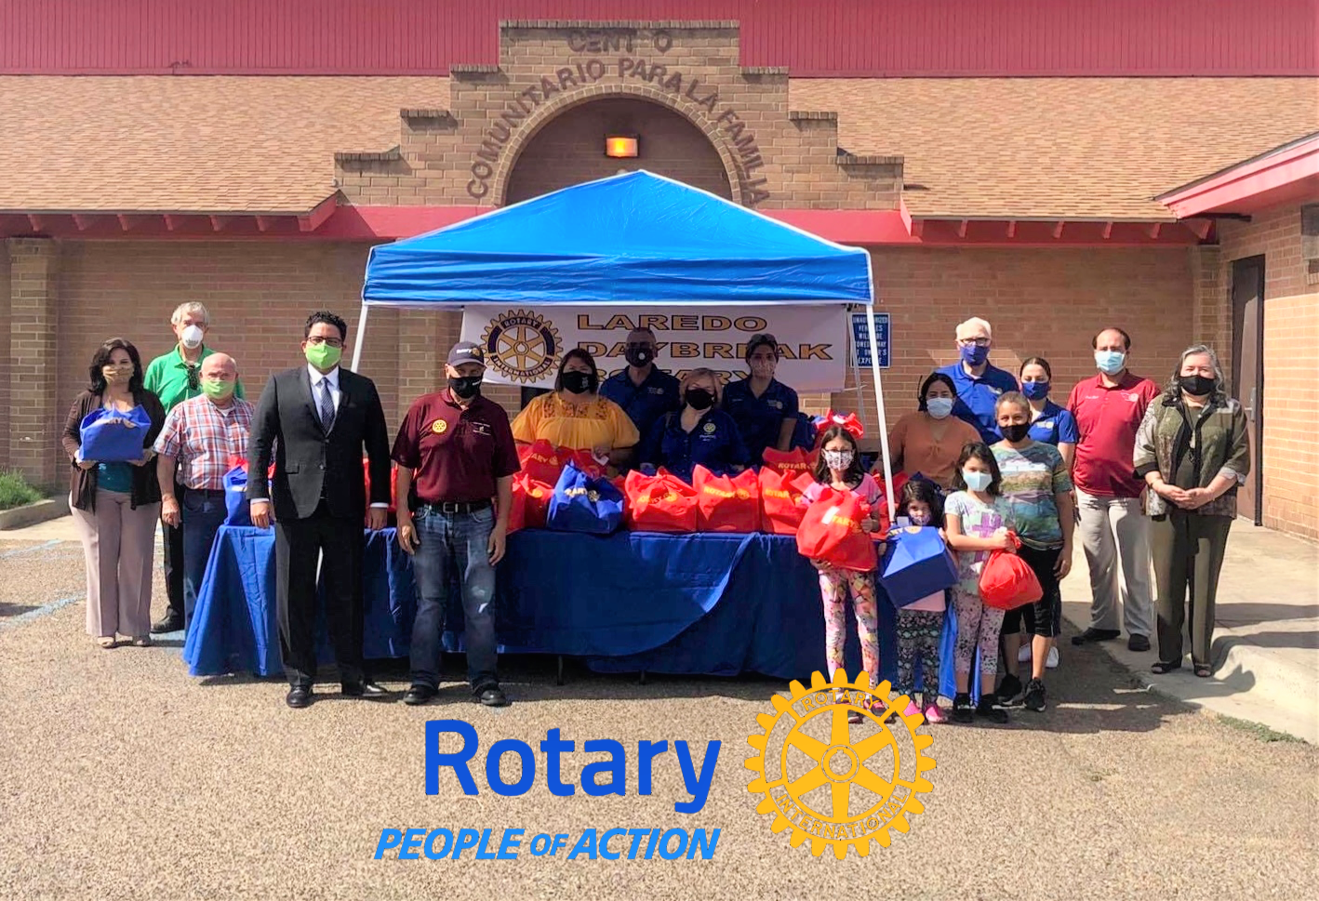
Target Audience
A target audience is the specific group of people you want to reach with your social channels.
They are the people who are most likely to be interested in your content, membership, or giving.
They are likely united by some common characteristics, like demographics and behaviors.

Slide 4
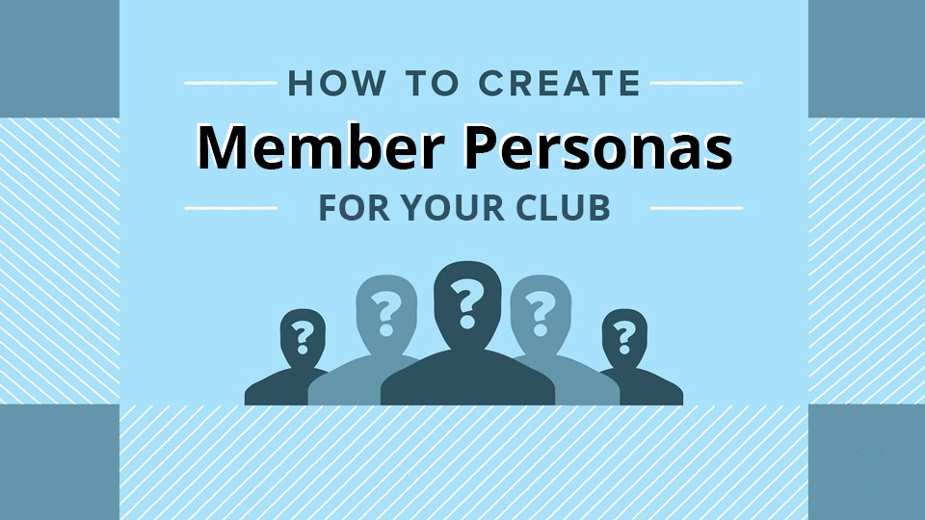

Slide 5


Look at Your Club
Get Specific
Every club is different
Every club is the same
Communities
Vocations
Gender
Age
Vocations
Income/education level
Interests
Rotary Reasons

Slide 6
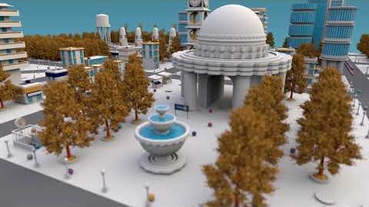
Anytown Video

Slide 7
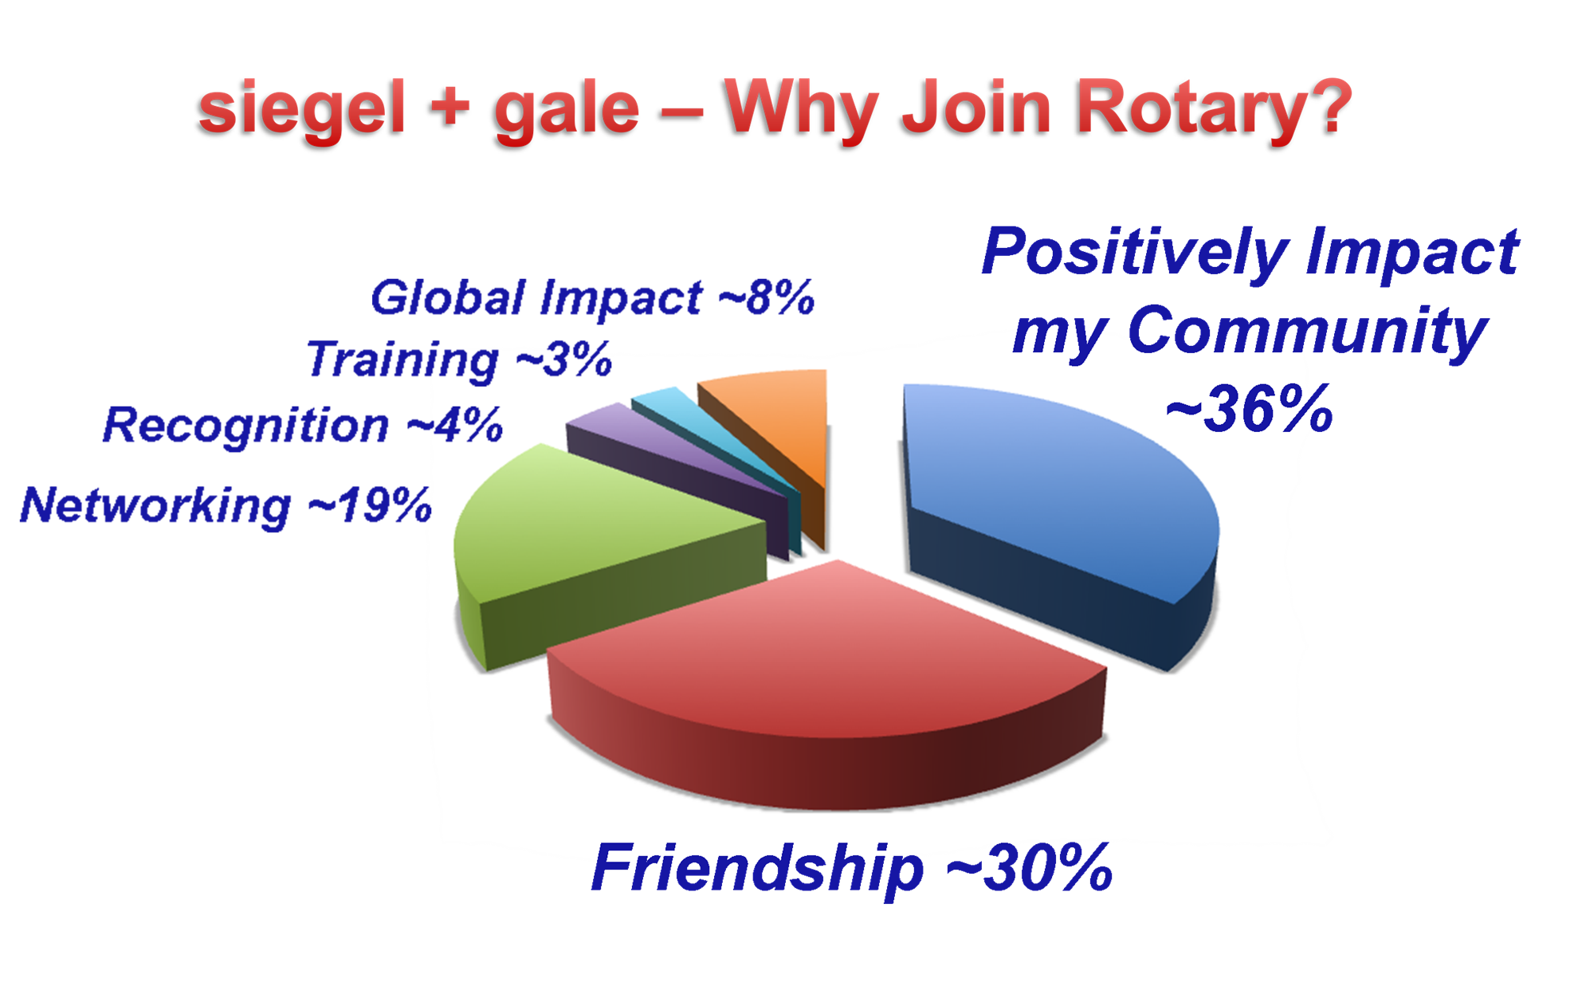

Slide 8
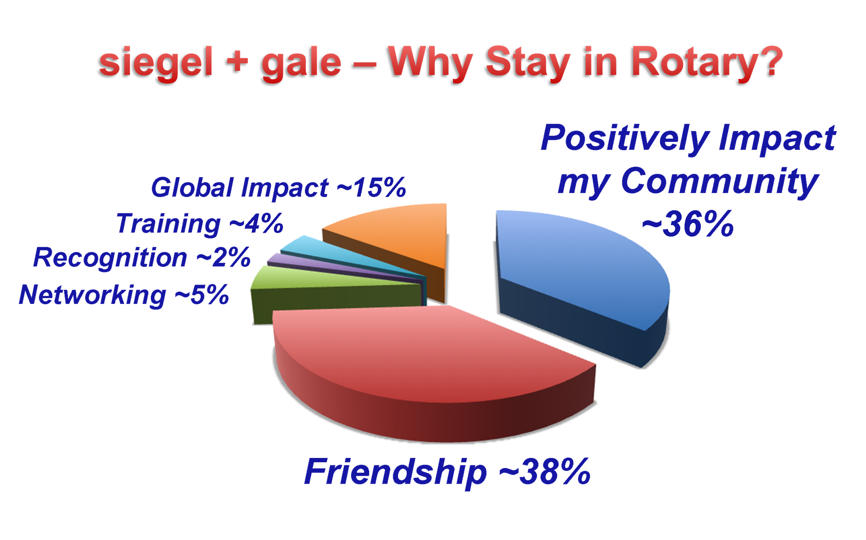

Slide 9
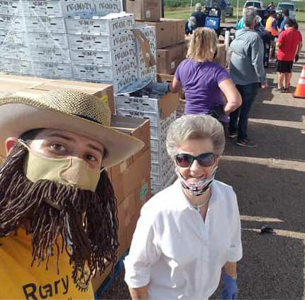
What Technologies?
Website
Social Media
Emails

Slide 10
Content
Websites
Create a Content Calendar
Leverage Your Content
Guest Posting
Action Pictures & Videos
SHARE
Represent Your Brand
Write Stories with Action Pictures
Enable Social Sharing
Accessible

Slide 11


Social Media
Emails
Claim your name/brand on all platforms
Choose one to start
Focus on conversation & engagement
Collect Emails from Guests & Speakers
Actively Engage Sign-ups
Consistent Template

Slide 12
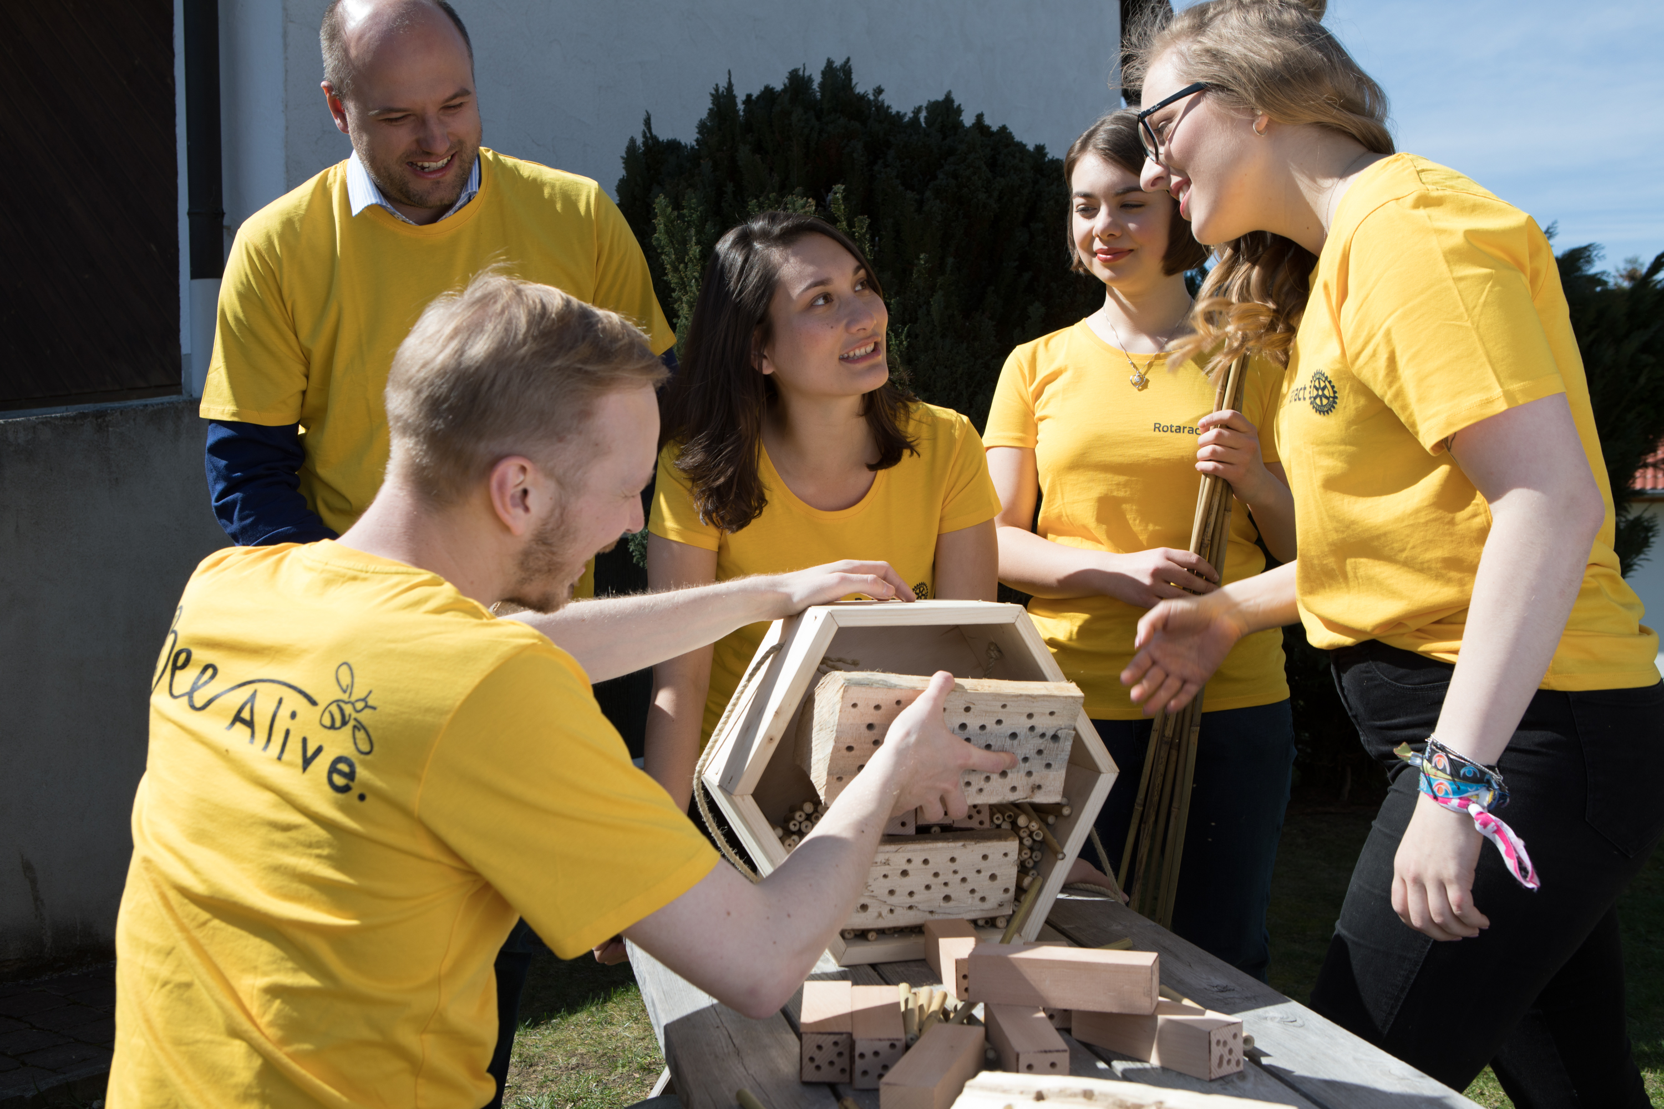
Storytelling
“We are, as a species, addicted to story. Even when the body goes to sleep, the mind stays up all night, telling itself stories.”
– Jonathan Gottschall (@jonathangottsch), The Storytelling Animal

Slide 13
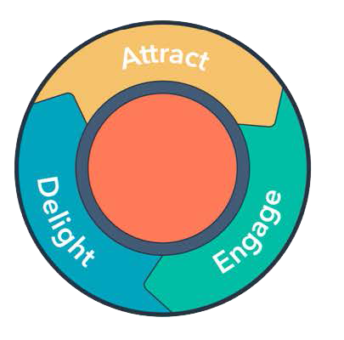
Content Marketing
In a nutshell, content marketing is the art of communicating with your prospects and members without having to sell to them.
As opposed to advertising your products and services, you’re creating helpful, engaging content that your prospects and members can enjoy and learn from.

Slide 14
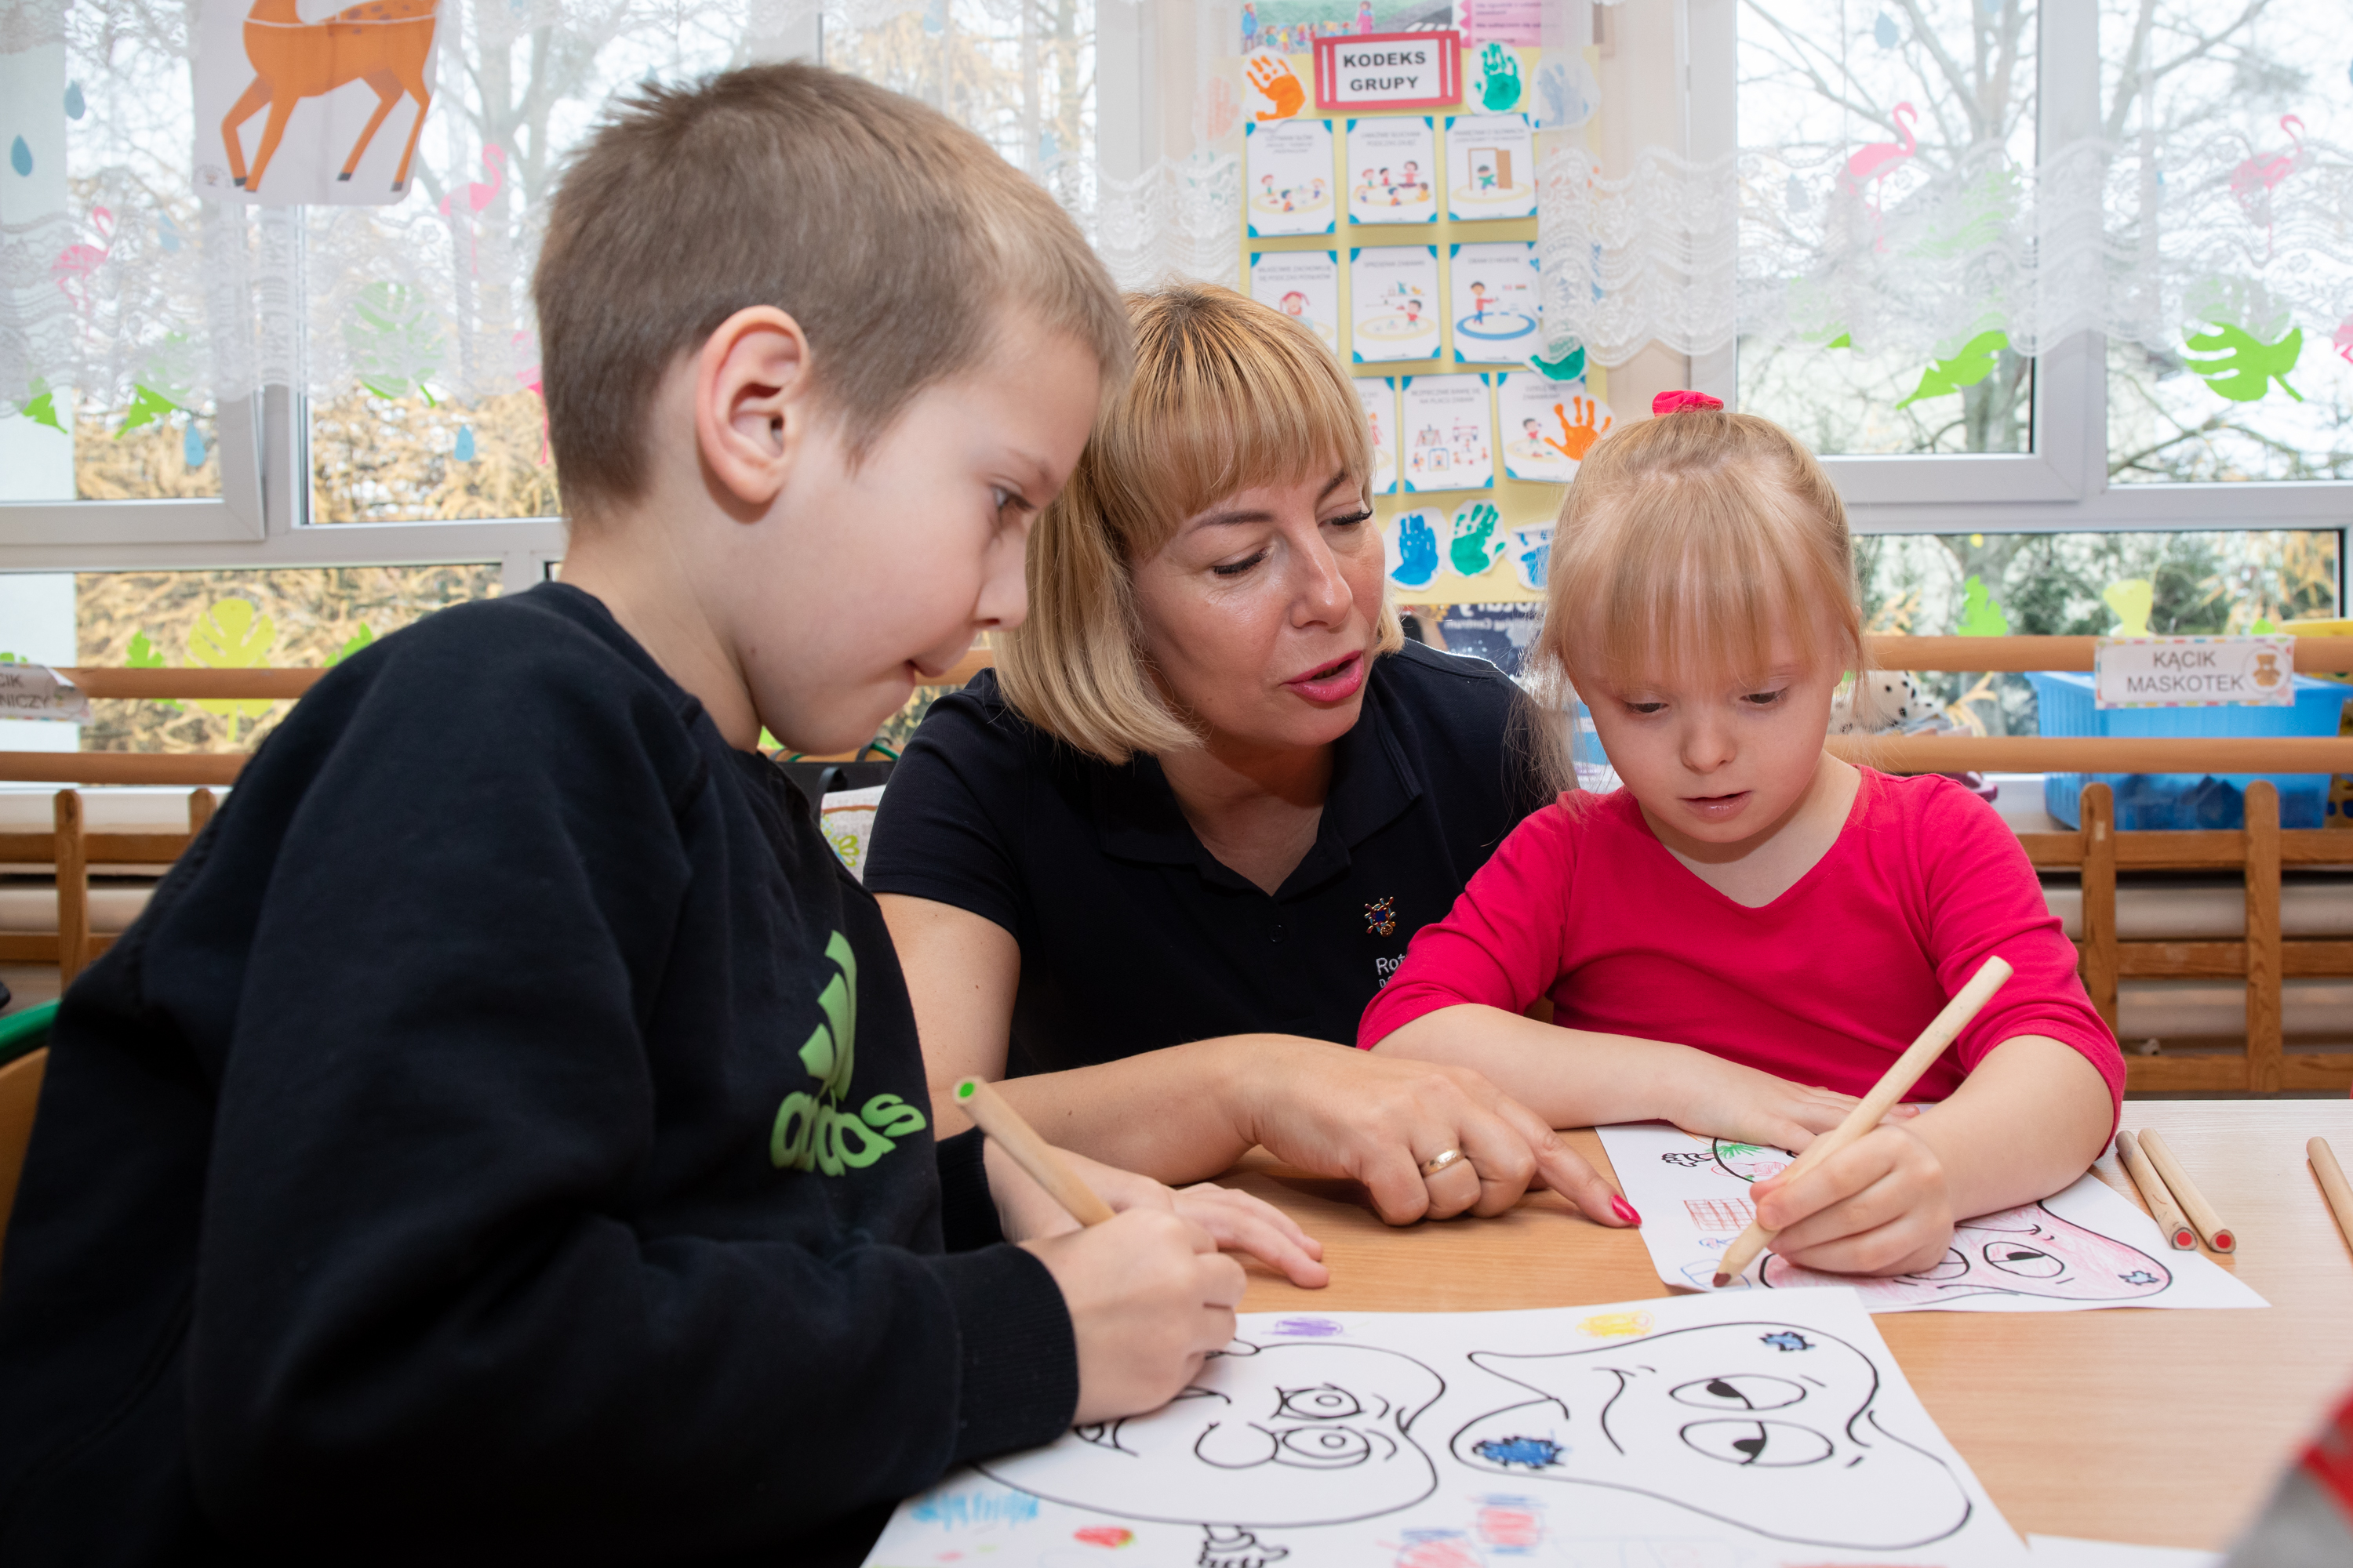
Tips for Content
Keep stories or blog posts 300-500 words
Include a featured image or video
Optimize posts to include target keyword
Make sure you have a call to action
Make sure you have a social sharing button
Social Media
Keep stories 100-150 words
Link to your website

Slide 15
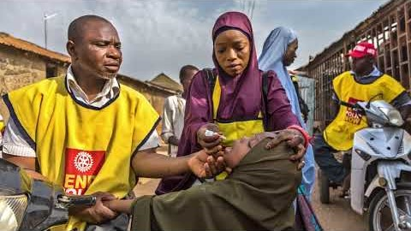
Rotary Responds Video

Slide 16
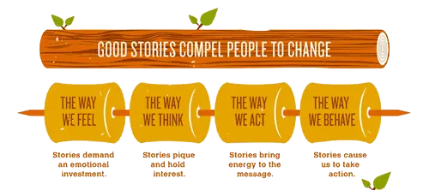

Slide 17



resources
Rotary International Brand Center
Rotary International Learning Center
District 5930
District 5930
People’s perception of Rotary comes from their experiences with our clubs and programs, along with the stories we tell and the images we share.
www.Rotary.org > Sign In > Manage > Brand Center
Promoting Your Club as People of Action
Take this course to learn how to build awareness of Rotary and the impact your club makes in the community by promoting your club as people of action.
www.Rotary.org > Sign In > Learning & Reference > Learning Center
The Toolbox page has many resources available to you in the Public Image section. Usually at least one new resource is added each month.
www.Rotary5930.org > Menu bar > Toolbox
Does not require a login.
Also on the District app.
The Toolbox will also have this presentation and some additional guideline sheets available after Tuesday, Oct. 6.
www.Rotary5930.org > Menu bar > Toolbox
Does not require a login.
Also on the District app.

Slide 18
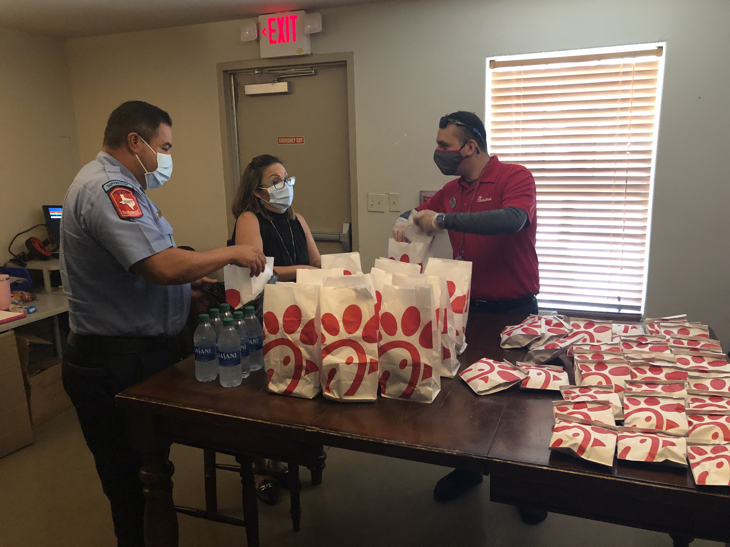
Thank you!
Nancy@rockportwebsites.com
361-463-8791

