Slide 1
DISTRICT 4-n-1 Training
DISTRICT 5930 October 17, 2020

Slide 2


What is your Passion and
How to Channel it?
Nancy Ross, LTG Club Administration

Slide 3
Rotary’S Guiding Principles
The Rotary Guiding Principles help the club carry out Rotary’s mission and understand our history of commitment to Professionalism and Service.
Primarily, a Rotary Club is a group of representative business and professional people and community leaders who have accepted the Rotary philosophy of “Service above Self”.
Because they who serve must act, Rotary is not merely a state of mind, nor Rotary philosophy merely subjective, but must translate itself into objective activity. The individual Rotarian and the Rotary club must put the theory of service into practice.
In carrying out the ideal of service, a variety of activities developed by Rotary clubs have afforded significant opportunities for Service by their members.
The Guidance for Rotarians and their Clubs are listed in the Manual of Procedure 2019 on pages 2 thru 5.

Slide 4
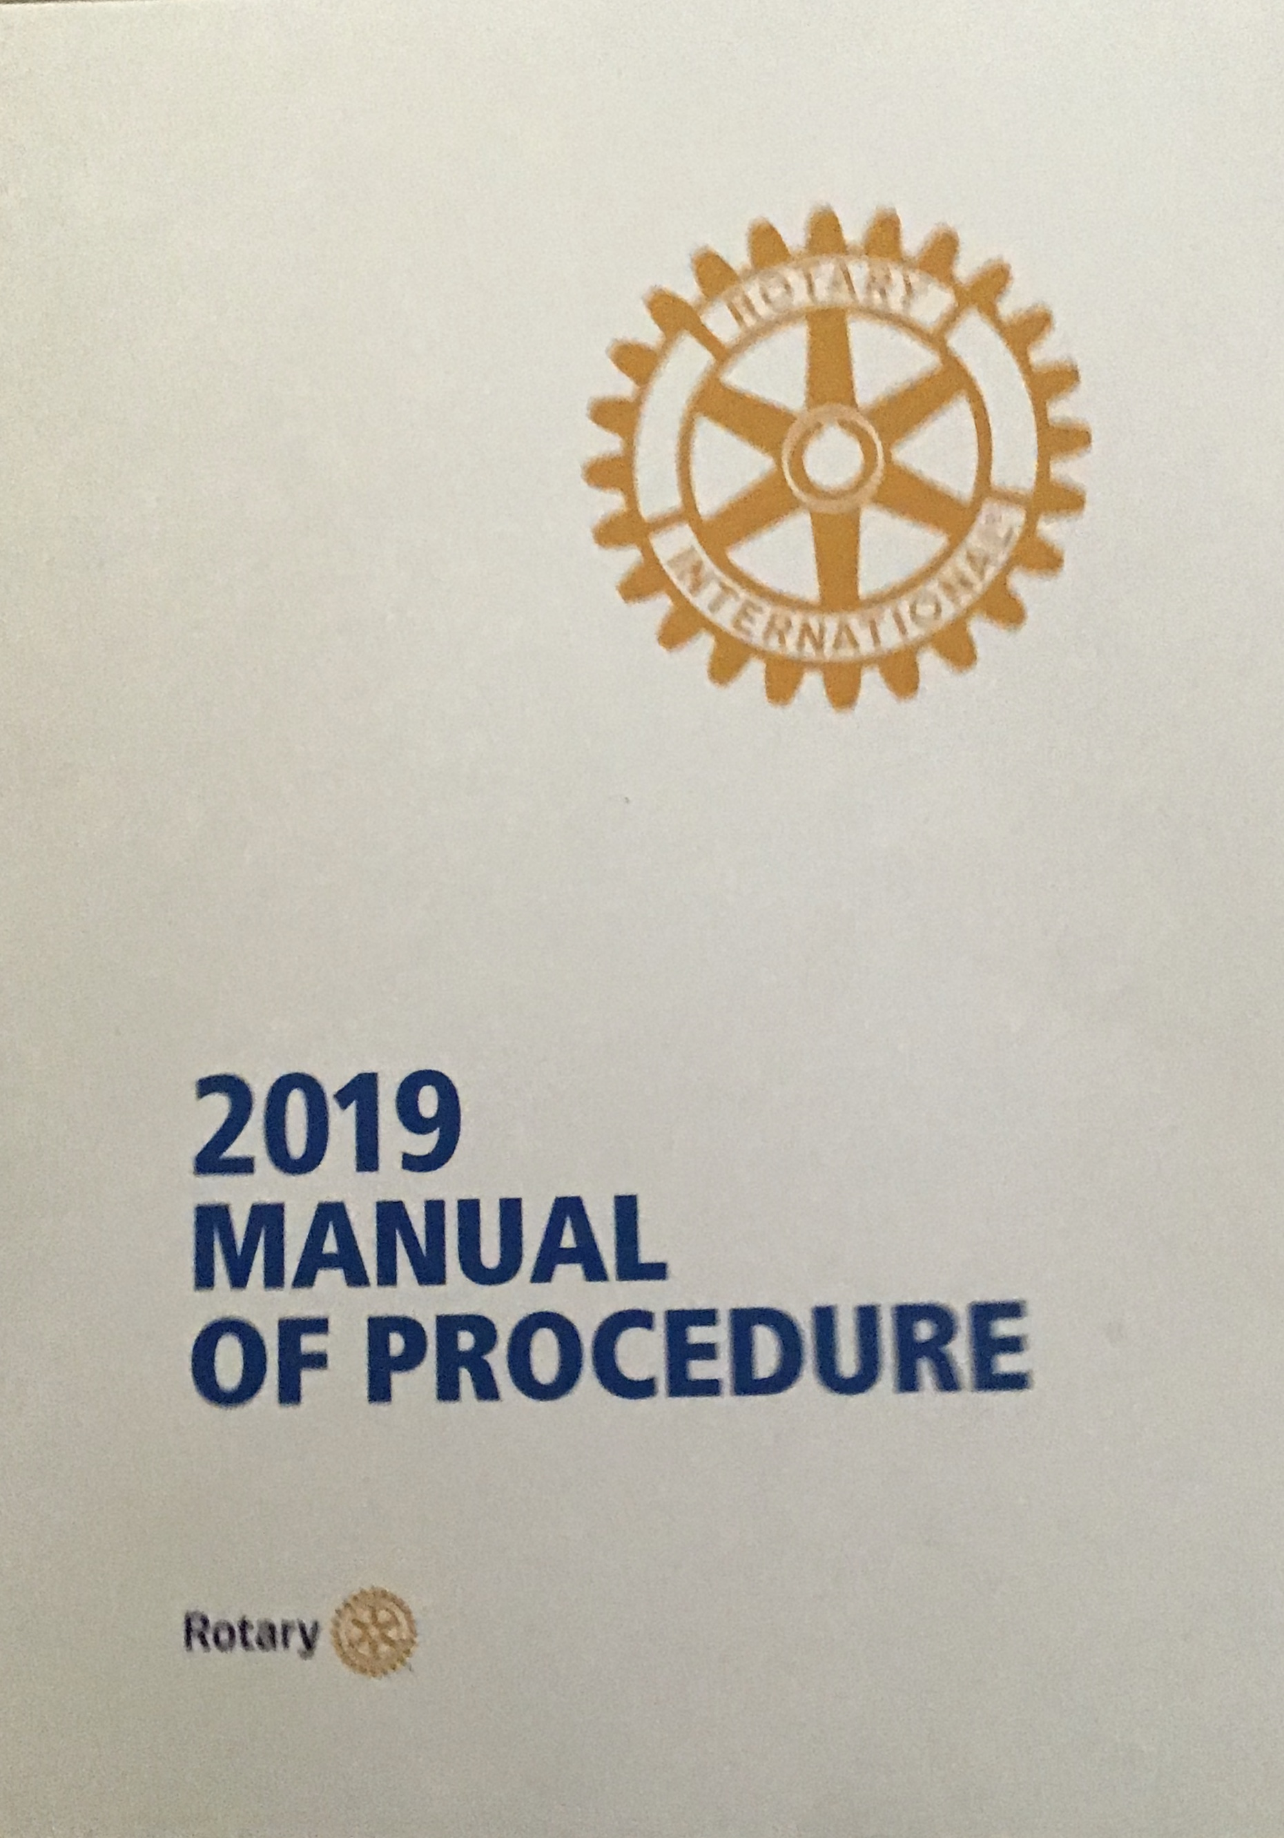
Manual of Procedure 2019

Slide 5
Rotary International
Club Service
Vocational Service
Community Service
International Service
Youth Service
Five Avenues of
Service

Slide 6
Five avenues of service
DISTRICT 5930
Club Service – Action a member should take within the club to help it function successfully.
Vocational Service – This promotes high ethical standards in business and professions and fosters the ideal of Service in the pursuit of all vocations. Rotarians should conduct themselves in accordance with Rotary principles and lend their vocational skills to club projects to address issues and needs of society.
Community Service – Various efforts that Rotarians make to improve the quality of life of those who live within the clubs locality.
International Service – Activities that Rotarians do to advance international understanding, goodwill, and peace by club projects designed to help people in other lands.
Youth Service – Implementation of positive change by youth and young adults through leadership development activities, involvement in community and international service projects, and exchange programs that enrich and foster world peace and cultural understanding.

Slide 7
WHAT iS Rotary - Video
DISTRICT 5930
https://www.youtube.com/watch?v=jLUpWV8z3ws

Slide 8
Rotary Club
Membership
Foundation
Public Image
Youth services
Fundraising/Service Projects
Committees

Slide 9
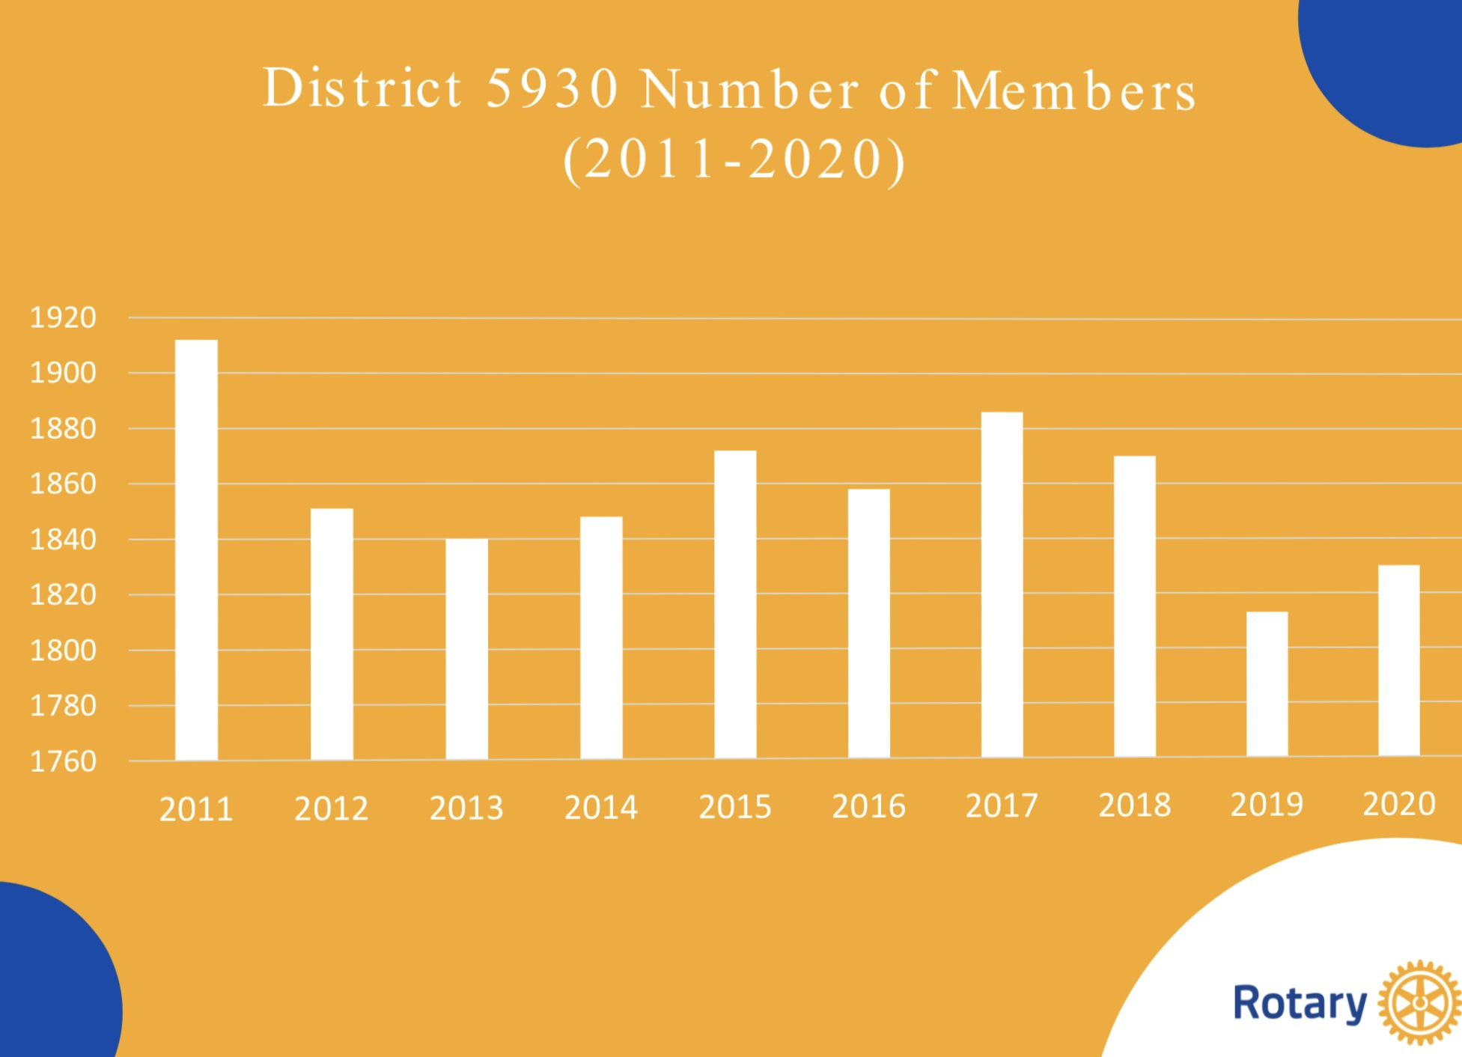
Membership
DISTRICT 5930

Slide 10
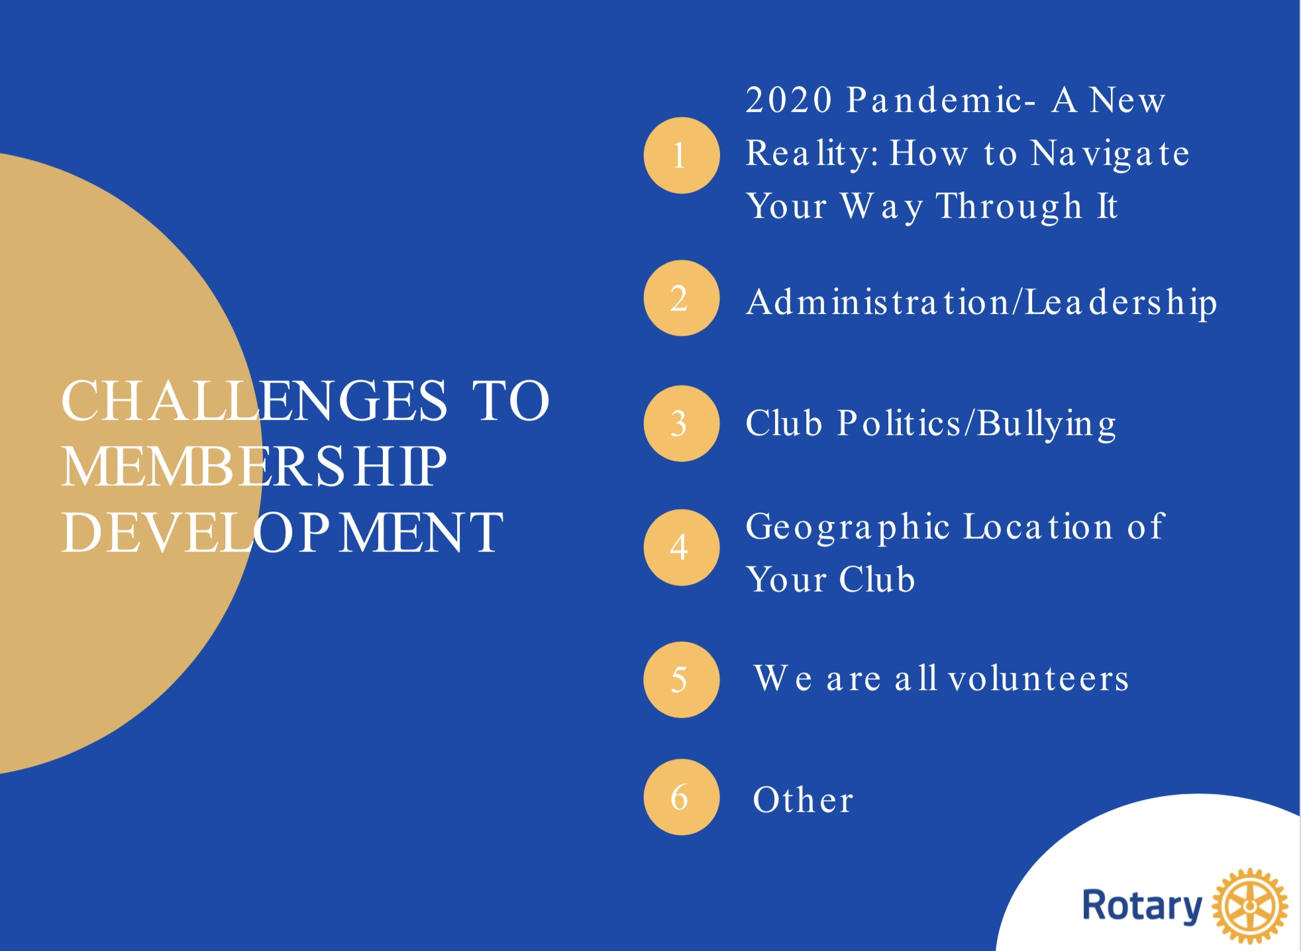
Membership
DISTRICT 5930

Slide 11
Membership
Leadership Tips & Reminders
▪ You all are leaders – keep sharpening your skills
▪ If you do not lead you will loose members
▪ If leadership is not innate to you – you can learn it (RLI)
▪ You cannot fire volunteers – use your charm
▪ Be Patient: Stop-Think-Act
▪ Always keep your cool – temperament
▪ Smile
▪ Be prudent
▪ Love your neighbor- Service Above Self
▪ Other
DISTRICT 5930

Slide 12
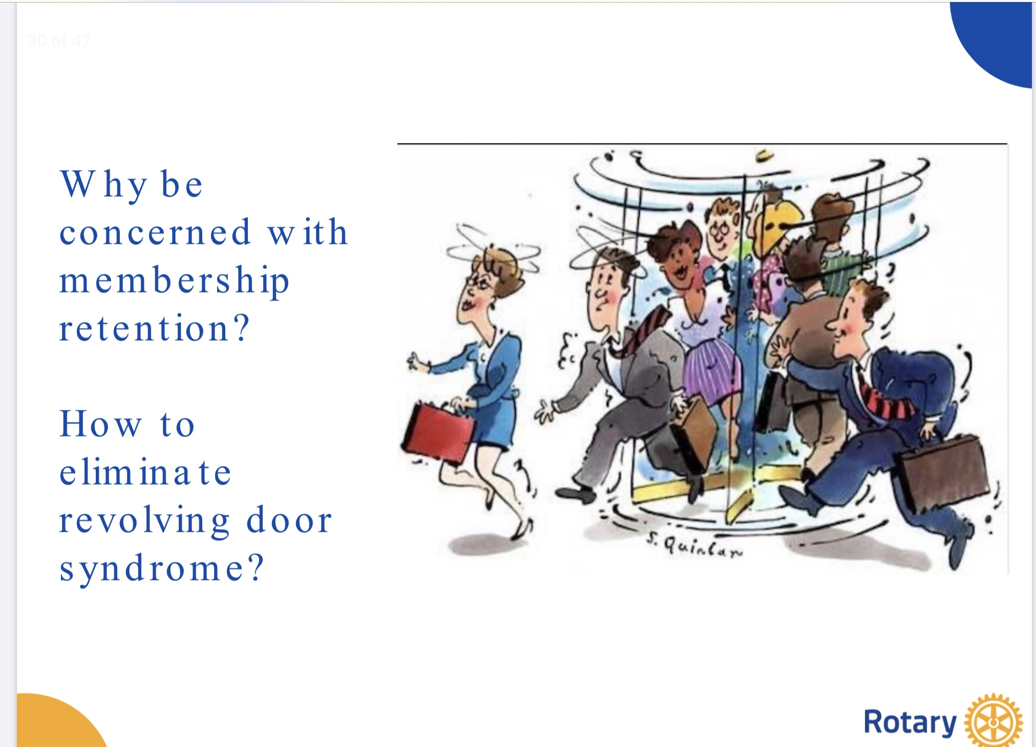
Membership
DISTRICT 5930

Slide 13
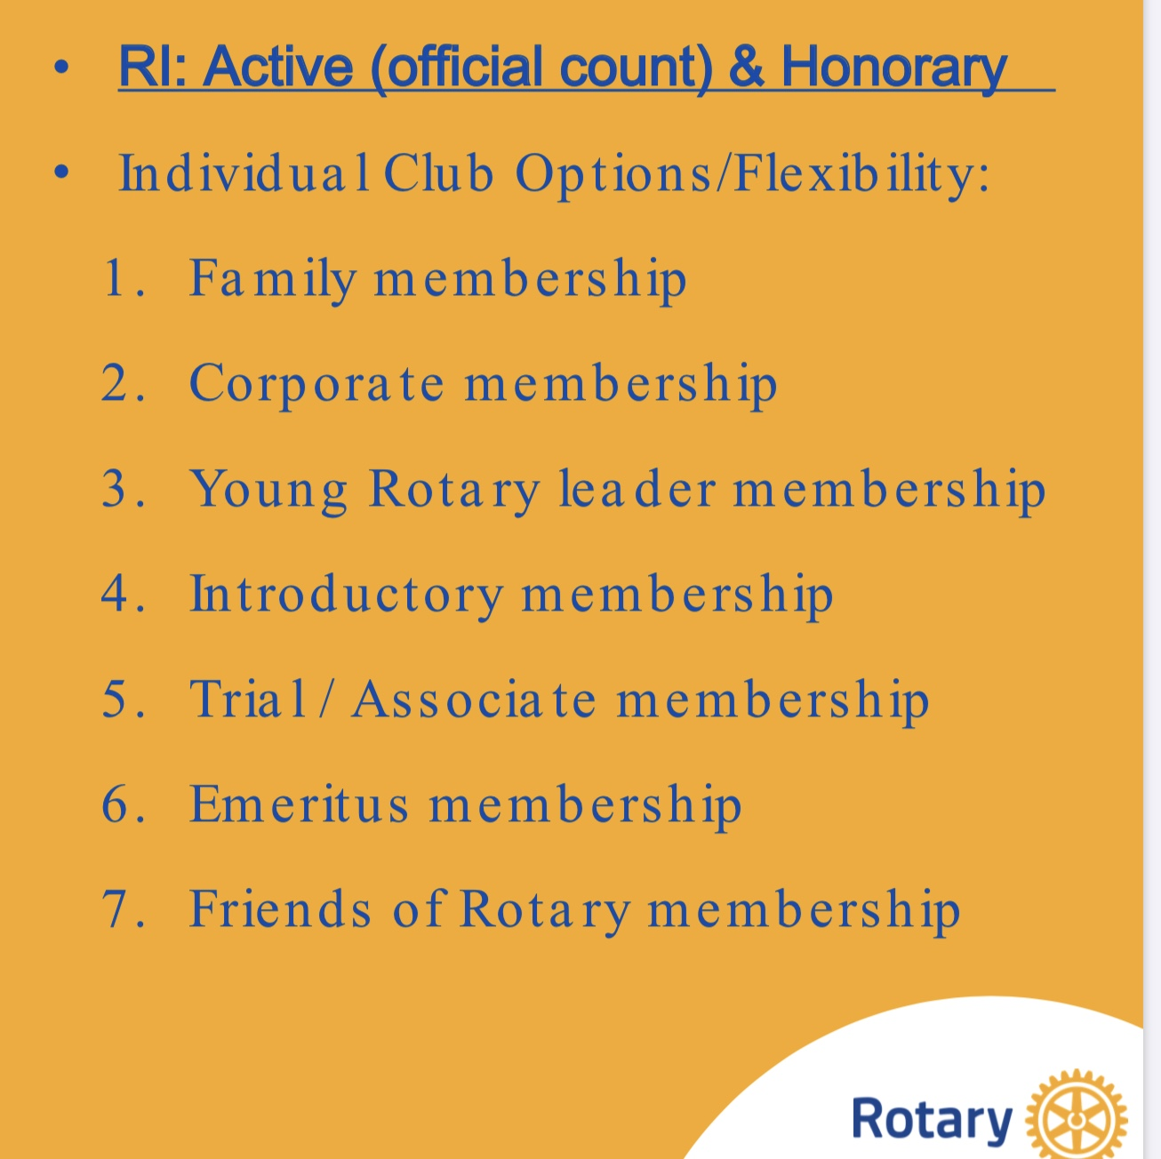
Club Member Categories
DISTRICT 5930

Slide 14
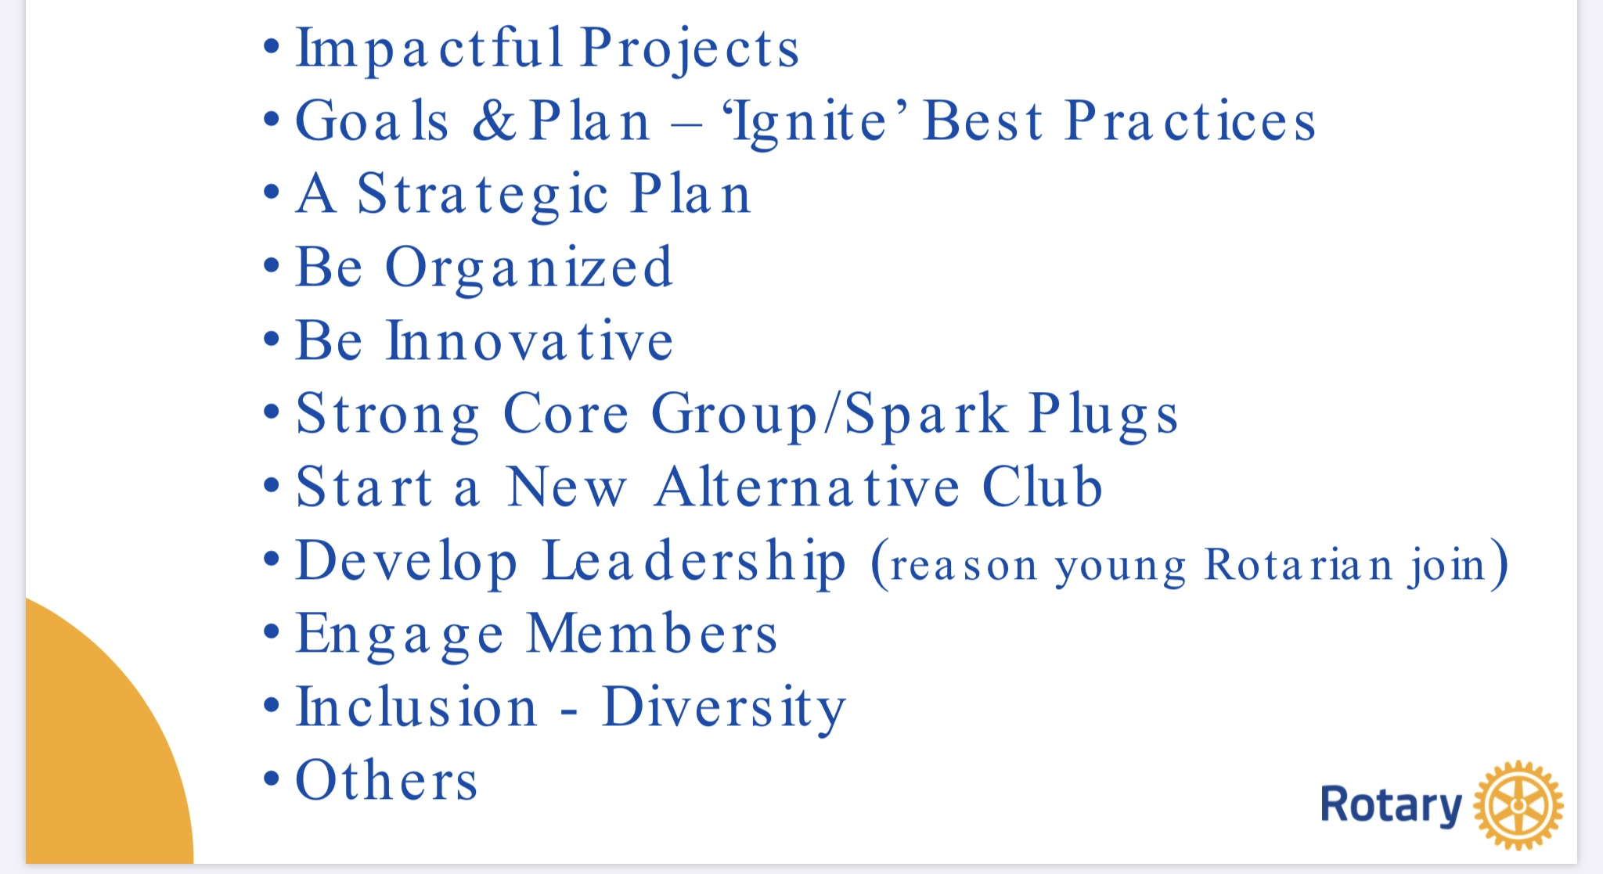
Simply Irresistable =
Vibrant = attractive
DISTRICT 5930

Slide 15
Ignite Program
Ignite was implemented in District 5930 in 2014. The rationale behind it is that every member has a role and commits to participate.
Ignite uses best practices research as the components of the program.
The clubs using Ignite have experienced a significant improvement in membership recruitment, engagement and retention.
How can you help – volunteer as Membership Chair or to serve on the Membership Committee. For Ignite, volunteer to coordinate the program for the club to include doing monthly Ignite reports to the District.

Slide 16
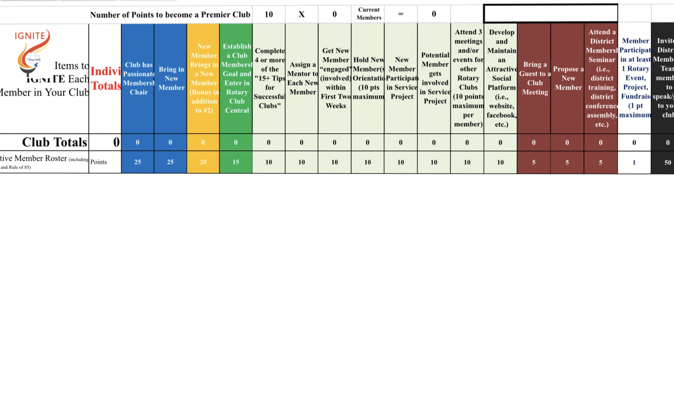

Ignite monthly report

Slide 17
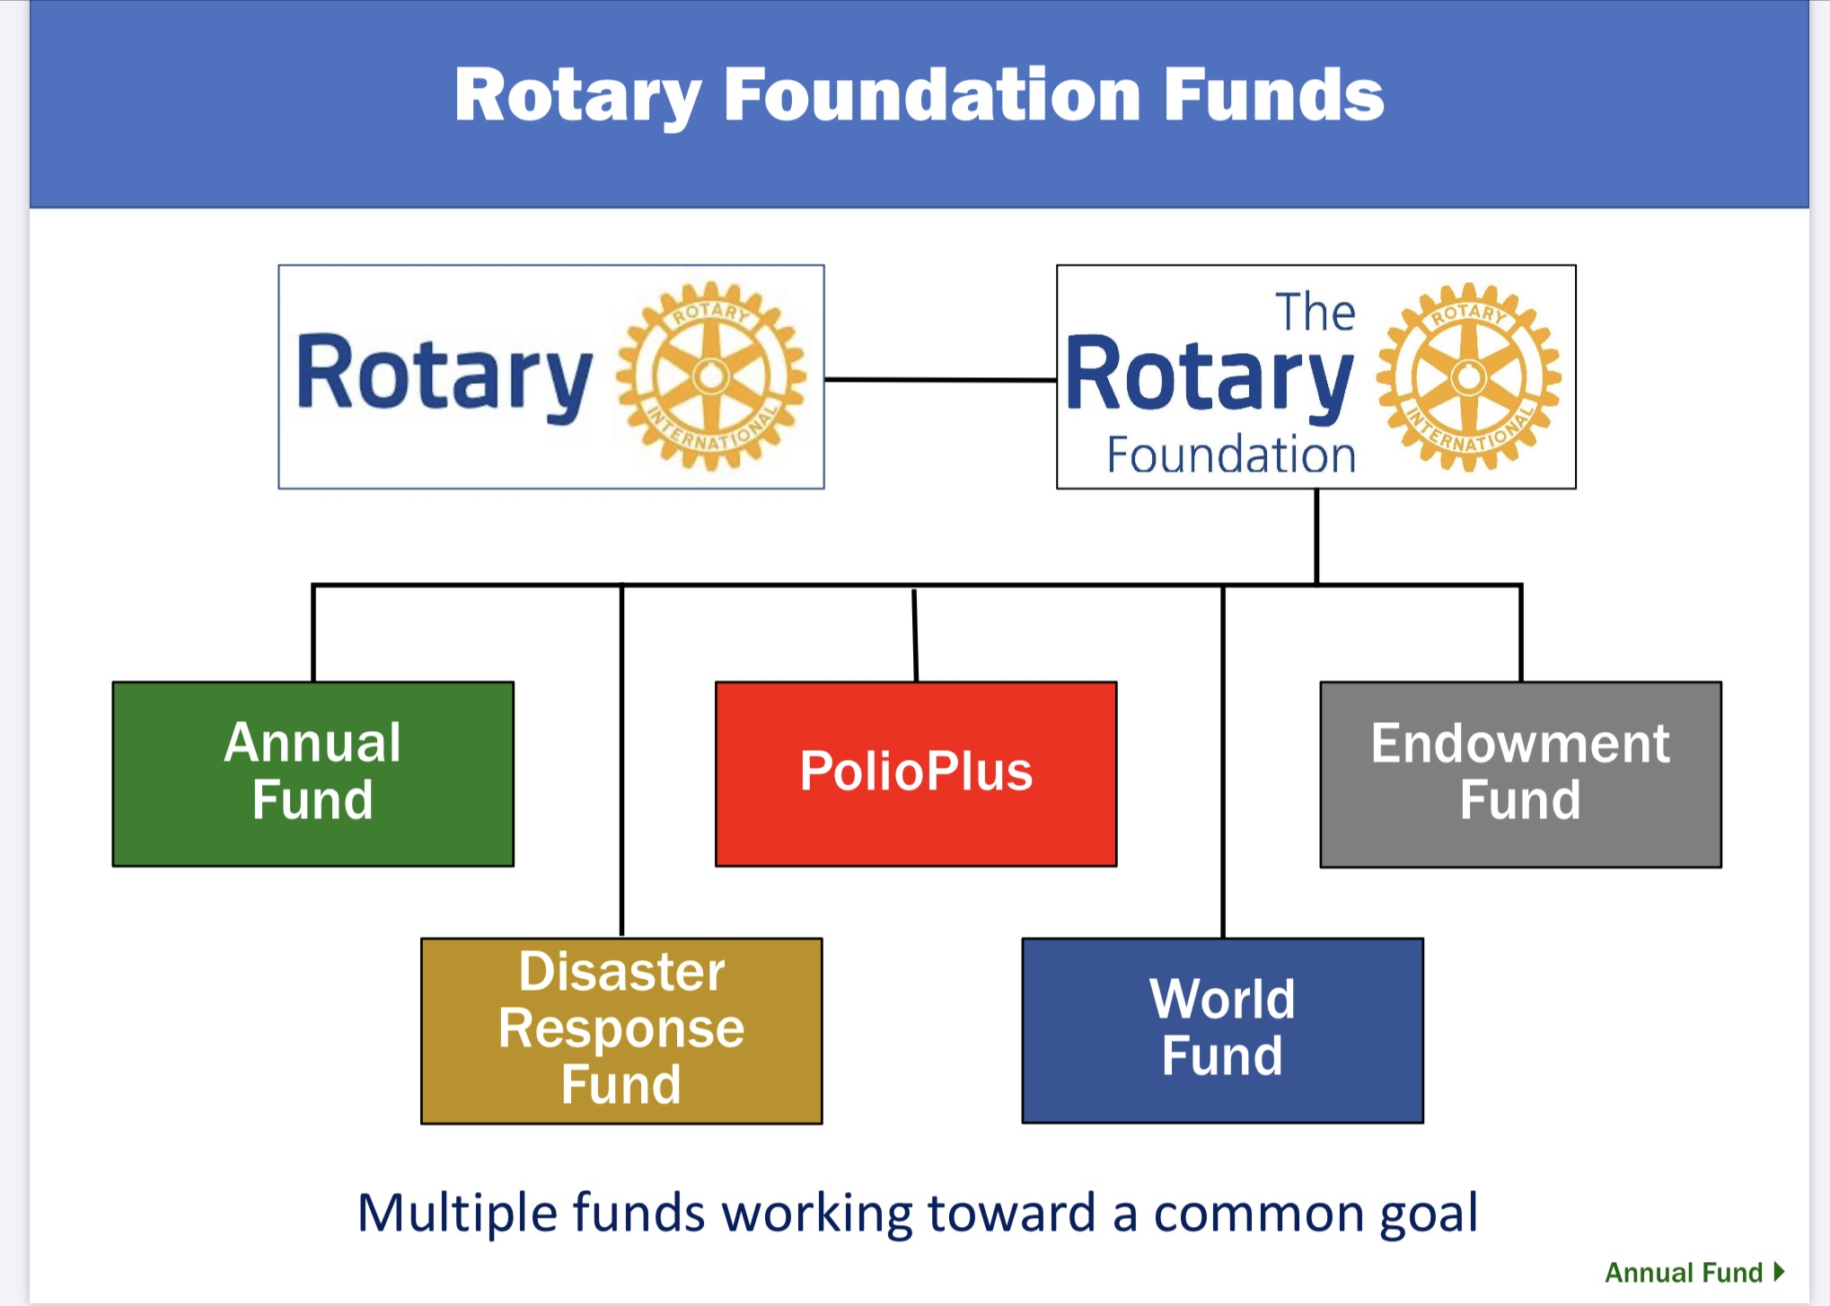
Foundation
DISTRICT 5930

Slide 18
What you can do to help
Promote the Paul Harris Society – make membership meaningful
Be a “Foundation Hero” – volunteer to be Chairman or on the Committee
Help develop specific fundraising plans to generate funds for Annual Fund and Polio Plus
Help club leverage the Foundation Points:
Match pool to promote Foundation giving
Reward member recruitment and reward service
Become a 100% Paul Harris Fellow Club

Slide 19
What you can do to help
Find speakers who can help your members better understand the value of the Rotary Foundation
Help your club make it easy to contribute
Help with invoices and requesting members to contribute thru the year
Set example by becoming a Sustaining Member ($100 per year donation)
Help set a Club Goal and increase participation rate
Assist with monitoring Rotary Reports on Foundation Giving
Volunteer to Chair or serve on Club Foundation Committee.

Slide 20
Public image
DISTRICT 5930
BENEFITS OF SOCIAL MEDIA
Social Media is a way for your club to connect with current and past members, prospective members, and donors, and friends. It is also an effective way to increase awareness of your club and the activities in your community.
EXTERNAL PUBLIC RELATIONS
Media – Local newspapers, Radio, TV. Develop contact list. Meet and get to know Journalists. Prepare News Releases including a Pitch Letter to pique their interest. Prepare Media Advisories for upcoming news events. Prepare Spot Announcements. Prepare Social Media posts.
Information on how to do Public Image documents is on the District webpage under Toolbox.
How can you help: Volunteer as Public Image Chair or to serve on the Committee.

Slide 21
Public Image Resources
DISTRICT 5930
Brand Central – www.Rotary.org. Guidelines and People of Action Campaign.
Facebook – Create Club page and share interesting or inspiring posts. Should originate 3-4 posts per week.
Twitter – Use online modules for learning basic and advanced tactics. Should do 1-3 tweets per day.
Instagram – Can learn Instagram basics online and should create 2-3 posts per week.
LinkedIn – Share Ara’s article every other day and post 2-3 times per week.
Utube - Post videos of club activities to promote your club and Rotary.
You can do paid advertising on Facebook Twitter and Instagram.
Volunteer to help your Club in Public Image by administering and posting in one or more of the Social Media’s.

Slide 22
Youth Services
DISTRICT 5930
Rotary believes in investing in our future by empowering young leaders, helping them learn leadership skills and giving them opportunities to have cross cultural experiences. Rotary Youth Services include:
Rotoract – Rotary Club for young adults 18 and over. Many are located on college campuses.
Interact – High School Clubs sponsored by a Rotary Club for students 12-18.
Early Act First Knight – A service project for middle school students in 4th and 5th grade. This is an opportunity to start educating young students in Service above Self and leadership skills.
RYLA (Rotary Youth Leadership Awards) – A leadership experience organized by Rotary Clubs and Districts for participants aged 14-30 develop their skills as a leader while having fun and making connections. The camp is usually done once a year for three days.
Rotary Youth Exchange – Rotary Clubs exchange students ages 15-19 internationally to learn a new language, discover another culture, and truly become global citizens.

Slide 23
Get involved in youth service
HOW CAN YOU BE INVOLVED IN YOUTH SERVICES:
Volunteer at youth-led service projects and invite youth to join you for your own Club Events.
Help Youth Clubs align their service with Rotary’s areas of focus.
Work with the youth clubs to exchange ideas how they creat a vibrant club
Help youth members to develop leadership skills, build connections in the community and become part of the Rotary family.
Volunteer to be Youth Service Chair or a Committee Member.

Slide 24
Fundraising/
Service projects
DISTRICT 5930
Rotary Clubs are making an impact in communities around the world.
The Rotary Club is responsible for planning and carrying out successful service projects that utilize funds and Club members time to benefit those in need.
Working on projects provides an opportunity for networking and socializing among club members. Keep members engaged by involving all members in service projects.
For each project, develop a timeline, establish criteria for measuring progress, and consider the resources and tools available to support you.
You may need to raise funds for projects your club conducts. Work with your club leaders and other Committee Chairs on fundraising needs and efforts. A successful fundraising event or campaign can support projects that make a real difference in successful service projects.

Slide 25
Fundraising steps to consider
Determine a set target goal amount and identify the type of event that will realistically yield that amount. Many clubs already have established their annual fundraising events.
Establish a budget for the fundraising event. Secure sponsors/contributors.
Determine how many people are needed to plan and carry out the event.
Committee members need to select date and venue for event; establish tracking procedure for receiving funds and expenses.
Publicize the event and monitor the progress.
After the event, evaluate the effort, recognize volunteers, contributors and sponsors. Ensure continuity for future fundraising events.

Slide 26
How can you help
Volunteer to Chair or serve on Service Project Committee.
Help find volunteers thru Rotarian families and friends; Rotaract and Interact students; members of other Rotary Clubs; and other Community organizations.
Coordinate with other club committees to maximize your club’s impact.
Attend Club Board meetings and provide ideas and input.
Share resources and skills you may have that will help the service projects.
Find partners for your club project by networking with Rotary members at District and International meetings.
Use Rotary Int’l and District websites to find information about Service Projects.

Slide 27
Looking for Leaders
DISTRICT 5930
How do you find leaders in the club to serve as Chair or a member of the Rotary Club Committees?
District Governor Elect Amando Chapa

Slide 28

QUESTIONS
&
Poll Question

