Slide 1

Presentation by
Aziz Memon
Trustee The Rotary Foundation
Member International PolioPlus Committee
Chair Pakistan National PolioPlus Committee
3-Sept-2020

Slide 2
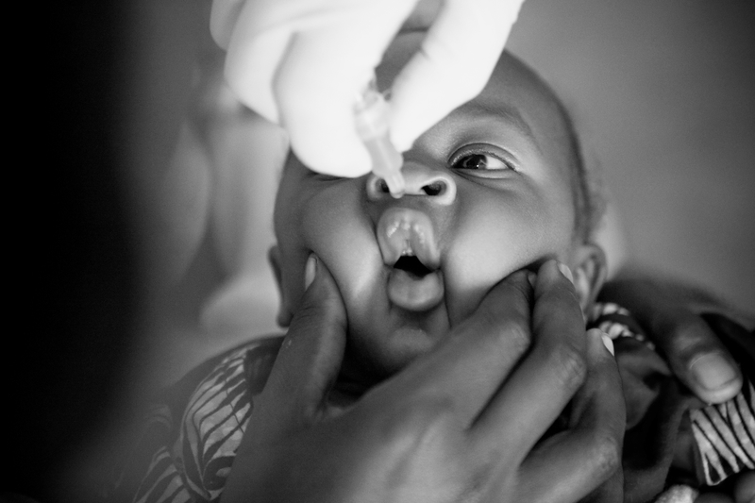
Why cVDPV2 Outbreaks Continue to Occur
Low immunity to type 2 cVDPVs due to:
Low routine immunization coverage in certain areas before the tOPV-bOPV switch (April 2016)
Declining mucosal immunity levels to the type 2 virus among children born after the Switch
Regional migration patterns leading to missed children in vaccination campaigns
Low-quality outbreak response campaigns
  Use of monovalent OPV type 2 (mOPV2) in outbreak responses, carries the risk of seeding new outbreaks in areas of low immunization coverage
2

Slide 3




Novel OPV2
New vaccine to address cVDPV2 emergency
Improved genetic stability to decrease risks of new cVDPVs
WHO Recommendation for an Emergency Use Listing (EUL) to enable roll out before the end of 2020
Production has started : Approx 200m doses of nOPV2 available this year
cVDPV2 Outbreak Response Strategy
GPEI Strategy for Control of cVDPV2, 2020-2021
Accelerating the development of nOPV2 is one component of the GPEI’s comprehensive new strategy to stop the spread of cVDPV2, characterized by improved outbreak response and attention to challenging contexts.
Optimize outbreak response using mOPV2, currently the best available tool for combatting type 2 vaccine-derived polio
Accelerate development of a new vaccine—novel OPV2 (nOPV2)—as a potential alternative for cVDPV2 outbreak response and ultimately as a replacement for mPOV2
Strengthen routine immunization and mitigate cVDPV risk by leveraging GPEI technical staff & synergizing efforts to strengthen immunization delivery systems in high-risk areas
Ensure sufficient supply of OPV2 is available to reach every at-risk child, utilizing innovative strategies as needed
3
Notes:
nOPV2
Brand-new vaccine to address cVDPV2 emergency and help secure lasting polio-free world
Modification of existing OPV type 2 to improve genetic stability and decrease risks of new cVDPVs
Working group to coordinate efforts across GPEI, and with regions
Objective : WHO Recommendation for an Emergency Use Listing (EUL)
Target : Approx 200m doses of nOPV2 available this year

Slide 4
nOPV2 : Initial use countries
Countries at Highest Risk of cVPDV2 Outbreak
and
Meet Initial Use Criteria
Africa – Burkina Faso, Cameroon, Chad, Côte d’Ivoire, Ethiopia
Asia Pacific – Philippines
Middle East/Asia– Afghanistan, Pakistan and Somalia
Countries at High Risk of cVDPV2 Outbreak
27 countries in the African Region* plus:
Djibouti, Iran, Libya, Sudan
Brunei, China, Malaysia, PNG
India, Indonesia
*The 27 countries are: Algeria, Angola, Benin, Botswana, Burundi, CAR, Congo, DRC, Equatorial Guinea, Eritrea, Gabon, Ghana, Kenya, Liberia, Malawi, Mali, Mozambique, Namibia, Niger, Nigeria, Rwanda, South Sudan, Tanzania, Togo, Uganda, Zambia, Zimbabwe
4

Slide 5
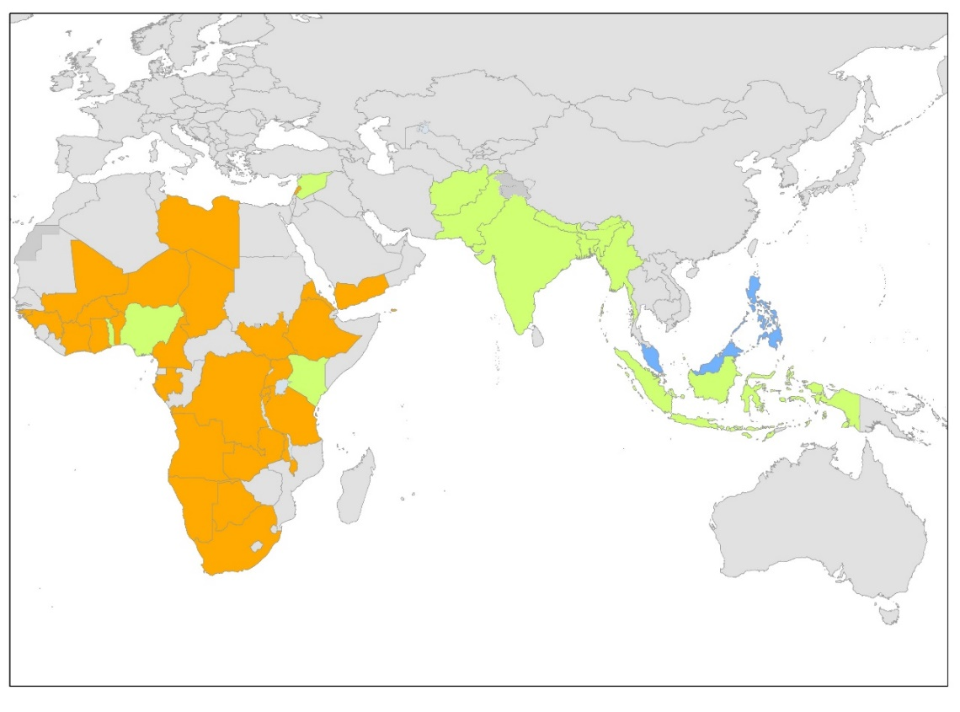

  Impact of Covid-19
Mass vaccination campaigns - 3 month-pause:
  Campaigns (polio, measles..) put on hold in > 35 countries
  At least 80 million children under one at risk of polio, measles, diphtheria, etc..
Polio Resources repurposed to support response to Covid-19
Planning now to resume activities
5

Slide 6
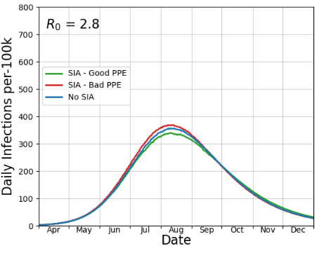
Potential impact of SIAs on COVID-19 transmission
Impact of a door-to-door urban campaign*
Model shows that SIAs likely to result in temporary, small increases in COVID-19 (<2%)
Provided that :
  Avoid SIA that may introduce COVID-19 to communities not previously infected
  Screen polio workers for symptoms to reduces risk to households
  Health worker use PPE (mask), sanitizer & limit physical contact as much as possible, particularly with adults, to reduce risk to households
Risk to polio workers can be significantly reduced by:
  Being from the same community
  Avoiding contact with symptomatic individuals (esp. adults)
  Reducing unnecessary contacts
  Reducing risk of infection (PPE (mask) and hand sanitizer, physical distancing)
Partial PPE
Assumptions: 80% of a HCW’s contacts are with children <5yrs during SIA periods. Good PPE = 95% reduction in infectivity rates. Partial PPE = 50% reduction in infectivity rates.
6

Slide 7
Conducting polio SIAs will NOT substantively increase COVID risk and the SIAs will significantly decrease polio transmission (and risk)
Recommendation: SIA should be resumed, provided
the programme addresses the following:
Consideration given to using SIAs to assist COVID-19 response and recovery efforts
Political commitment at all levels, in all areas
Careful assessment of health and availability of health workers
SIA plan informed by community perceptions, and rationale for SIAs credibly communicated
Adaptations to SIA operations to reduce COVID risk
Notes:
From Pakistan TAG meeting
Recommendation: SIA strategy for remainder 2020
Principles:
Prioritize cVDPV2 elimination over WPV1 control for remainder 2020
Use type 2 vaccines early and at large scale (tOPV is a critical tool Pakistan needs - make all efforts to use it in 2020)
Avoid schedules that result in repeated visits to households every few weeks
Be nimble to evolving global vaccine supply and cVDPV2 epidemiology
Pay specific attention to continuous WPV transmission areas (in particularly South KP & central Pakistan)
Recommendation: SIA designed within broader context of COVID-19
Communities facing unprecedented stresses and needs
There is a significant risk to a “polio only SIA” approach given COVID-19 disruptions and community need
BEFORE mass scale SIAs restart, it is imperative that the program and NCOC carefully consider the SIA design, informed by data on perception from communities and health workers. Options to consider include SIAs supporting:
COVID-19 public health response (e.g. soap, mask, COVID-19 information distribution etc.)
Promotion of COVID-19 ‘recovery’ initiatives (e.g. Ehsaas monitoring)
Reinforcing other essential health needs (e.g. nutrition and others)
Referral / linking to essential immunization catch up
Caution: No promises that cannot be fulfilled – promise less deliver more

