Slide 1

Step right up-
Everyone’s a winner!
Membership Program D5930

Slide 2
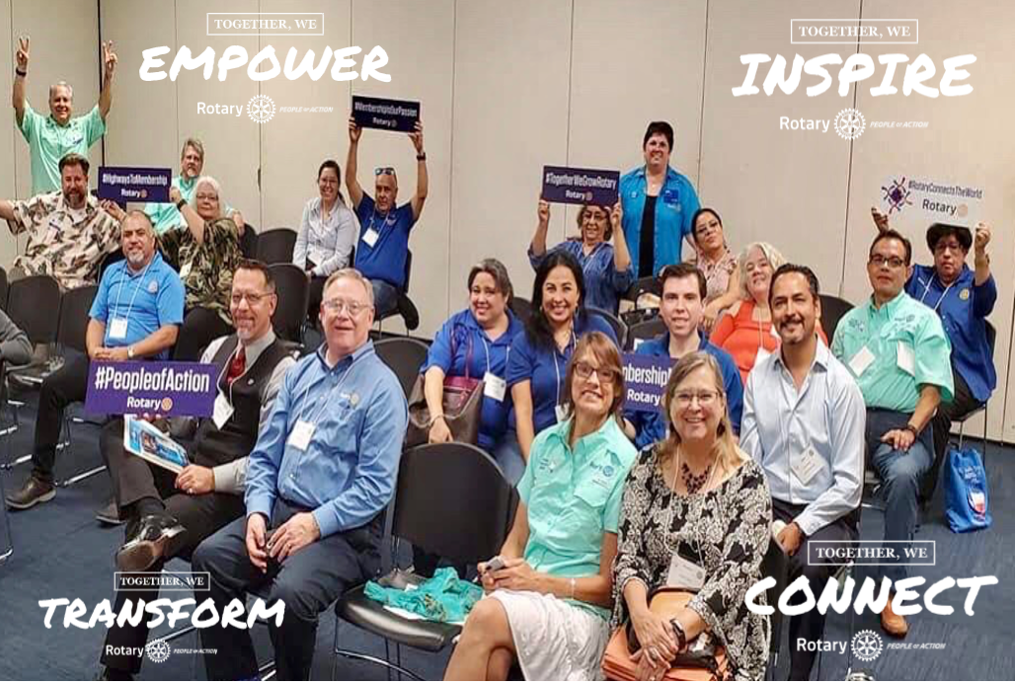

Slide 3

Goal:
The participants will learn and gain the tools needed to champion a strong membership program for their respective clubs.

Slide 4
Agenda:
  Introduction
  What is meant by strong membership?
  Importance of having a strong membership
  Challenges to a strong membership
  How can we achieve a strong membership
  How to make your club vibrant
  Q&A

Slide 5
Why is
strong membership
Important?
Poll 1
Notes:
Ideas: Effective communication
Respect for each other
Everyone has a voice
Everyone is engaged
All members are welcome
Inclusive and diverse
Member retention
Engaged members
Greater capacity to serve others
People of Action attract like minded prospective members
Grow Rotary membership

Slide 6
Open Discussion
(Gallery View)

Slide 7
Challenges to a strong membership?
Poll 2
Notes:
Ideas: Weak leadership
Negative club culture/bullying
Ineffective communication
Resistance to change
Not meeting members’ expectations
Lack of engagement
No accountability
Lack of a vision
No Strategic Plan
No membership recruiting, orientation, development and retention plans
Maintaining an effective membership chair and team
No club leadership succession plan

Slide 8
Open Discussion
(Gallery View)

Slide 9
How can we achieve a
strong membership?
JamBoard
(screen share/z)
Notes:
Ideas: Effective communication
Strong leadership
‘Ignite’
Focus on leadership development
Survey members periodically to better understand and meet their expectations
Identify and remove barriers that may prevent membership growth and retention
Publicize and share your Rotary stories to attract new members
Champion meaningful and impactful community service projects
Access your existing club membership to identify opportunities to attract and invite members not currently represented in your community
Explore new membership types (ex. Corporate, family, sponsorships, etc..)

Slide 10
What is
Club Culture?

Slide 11
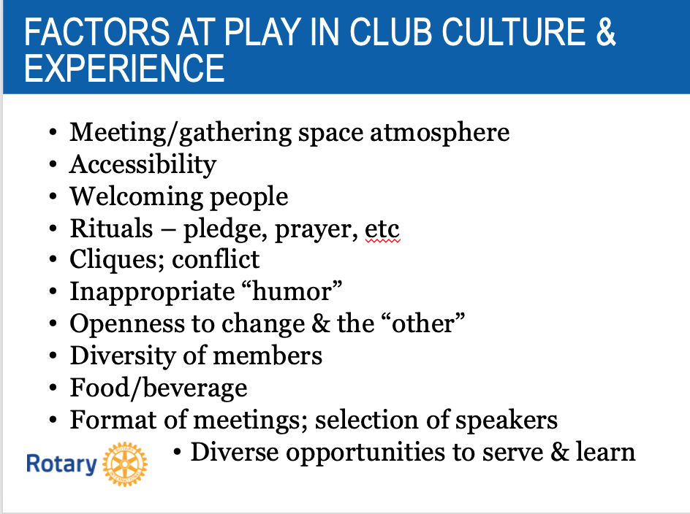
FACTORS AT PLAY IN CLUB CULTURE & EXPERIENCE

Slide 12


Slide 13
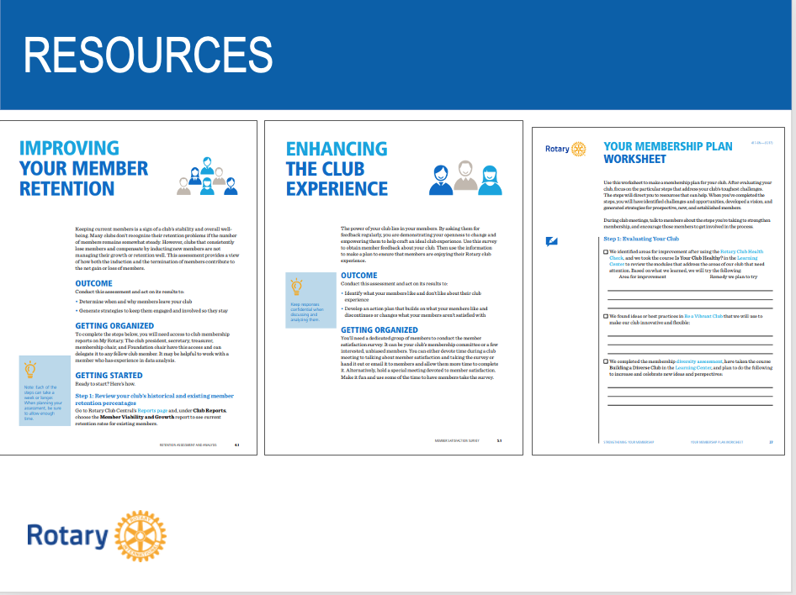
RESOURCES
Rotary.org

Slide 14
What is a Vibrant Club?

Slide 15
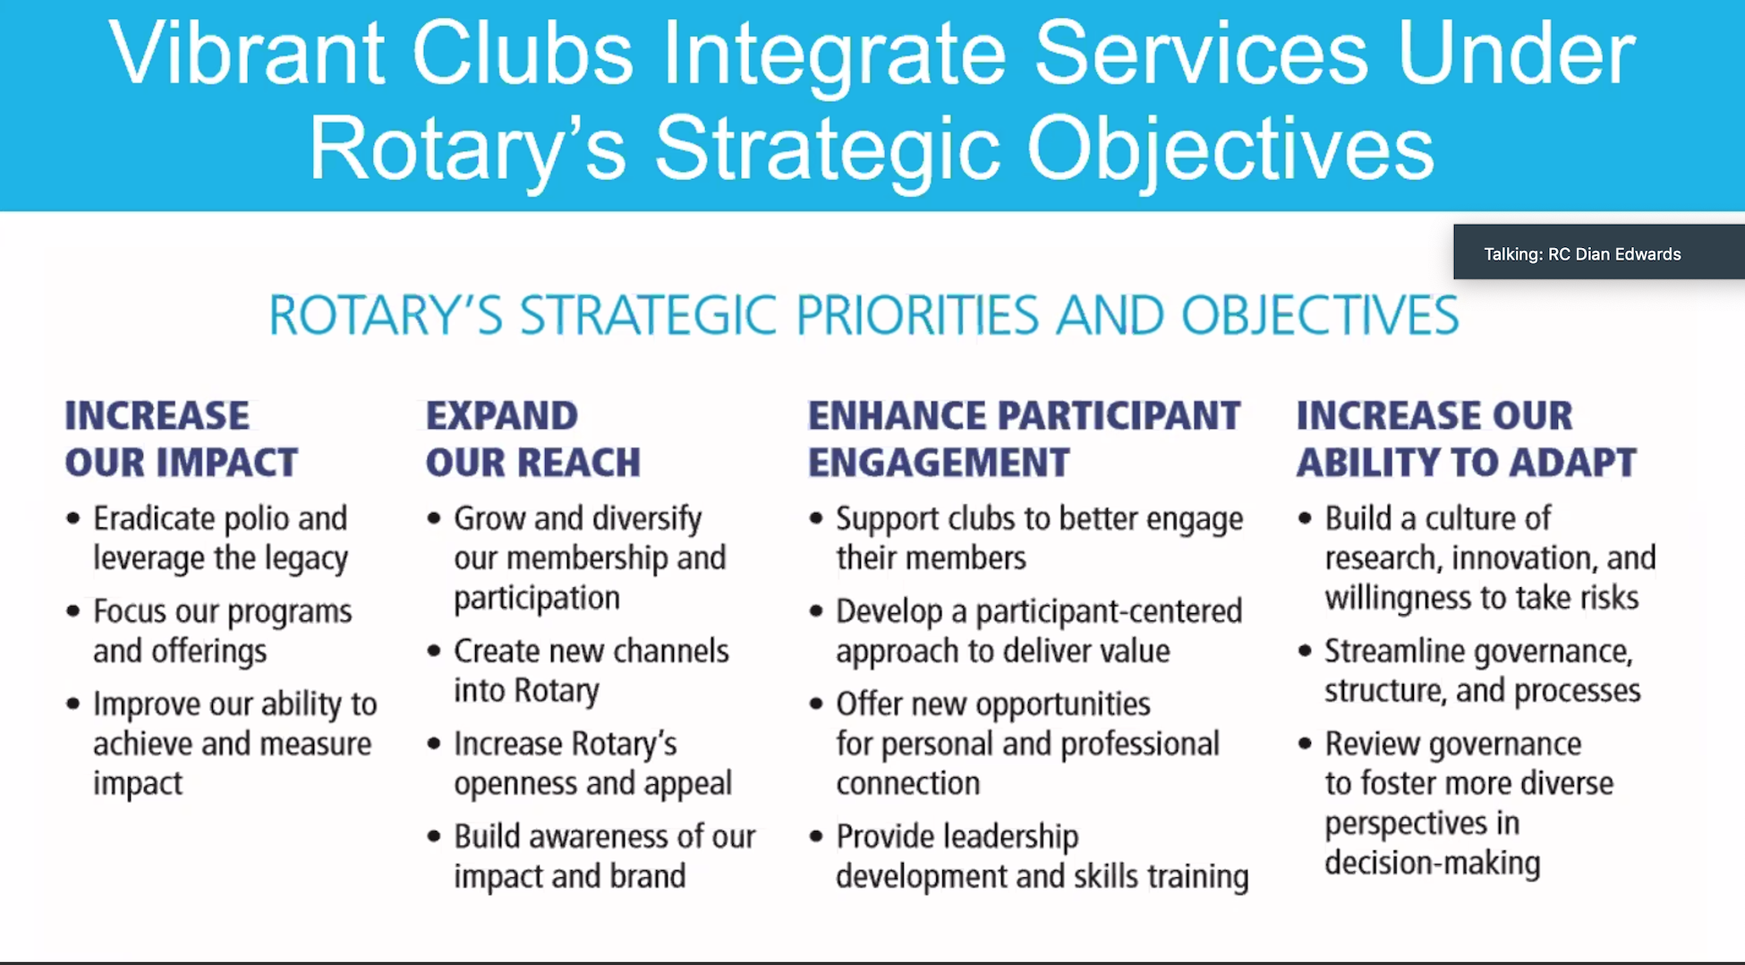
Vibrant Clubs Integrate Services Under Rotary’s Strategic Objectives

Slide 16
Simply Irresistible = Vibrant = Attractive
  Impactful Projects
  Goals & Plan – ‘Ignite’ Best Practices
  A Strategic Plan
  Be Organized & Innovative
  Strong Visual Presence
  Strong Core Group/Spark Plugs
  Start a New Alternative Club
  Develop Leadership (reason young Rotarians join)
  Engage Members
  Inclusion - Diversity
  Others

Slide 17
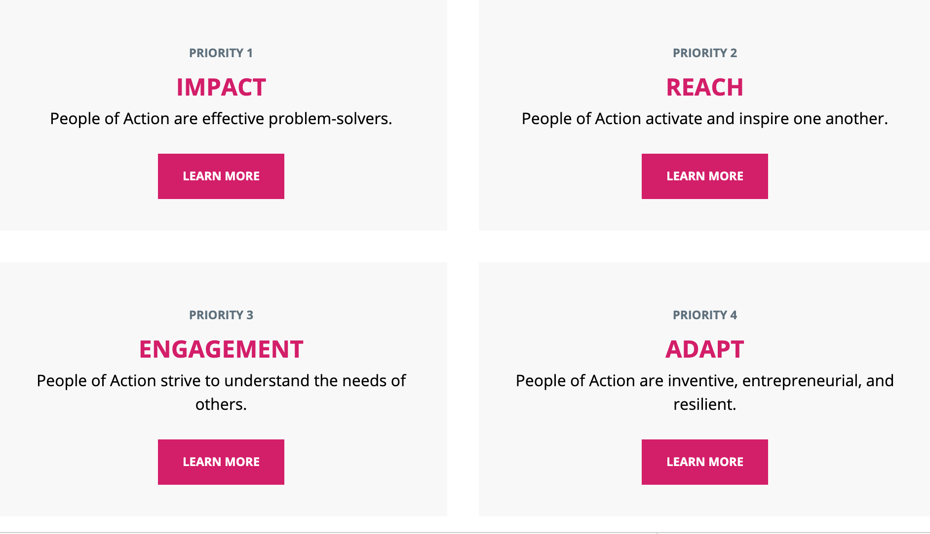

Slide 18


Slide 19
Leadership Tips & Reminders
You all are leaders – keep sharpening your skills
If you do not lead you will lose members
If leadership is not innate to you – you can learn it (RLI)
You cannot fire volunteers – use your charm
Be Patient: Stop-Think-Act
Always keep your cool – temperament
Smile
Be prudent
Love your neighbor- Service Above Self
Other

Slide 20

Questions

