Slide 1


subhead
IS YOUR FRIEND

Slide 2
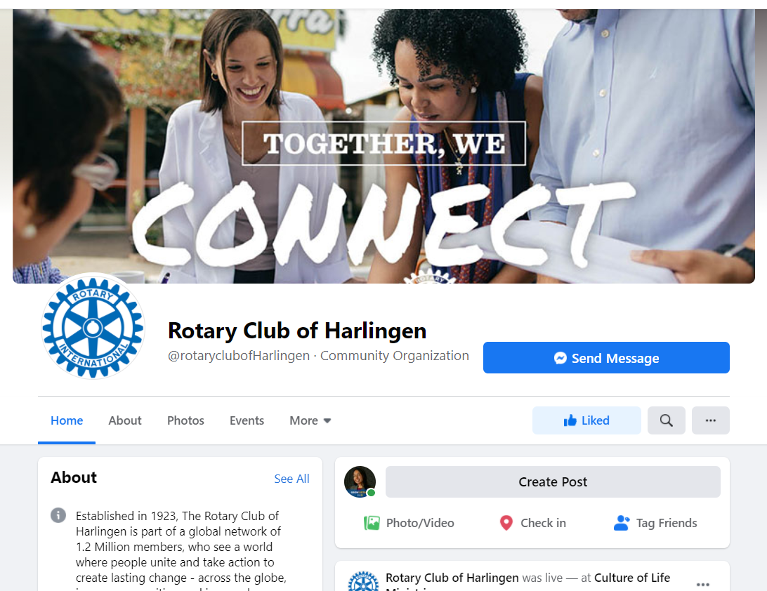
fACEBOOK
In addition to our websites, we need a strong social media presence too.
Why we need to learn to use Facebook?
How to understand our audience?
What type of content to post and when?
How to develop a social media plan?
ROTARY QUICK START GUIDE FOR CLUB SOCIAL MEDIA PAGES

Slide 3
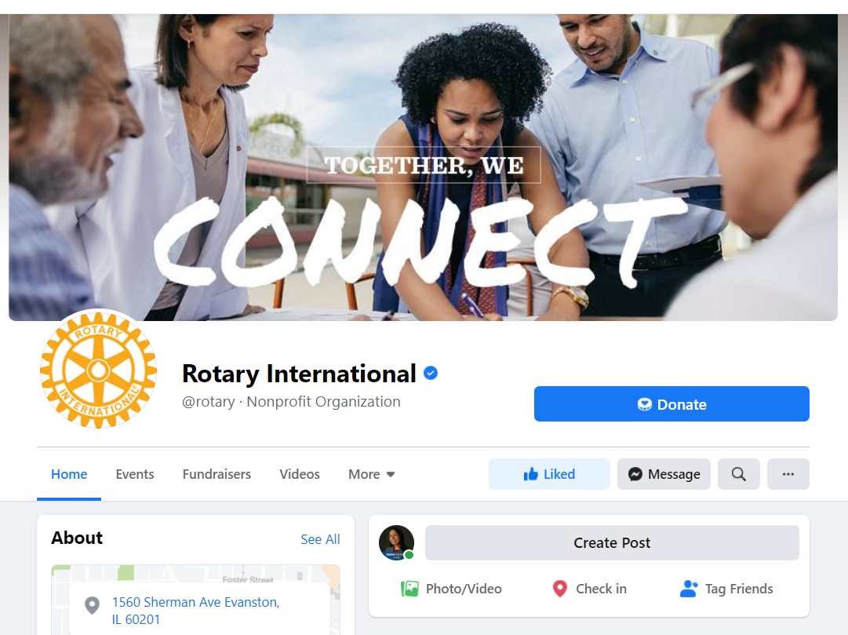
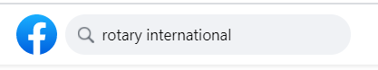
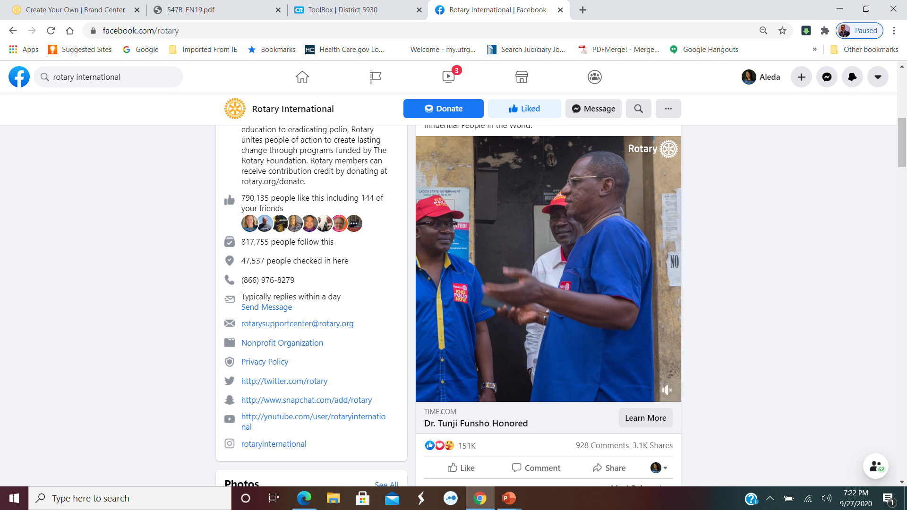
Benefits of being friends
CONNECT
Current and past members
Prospective members
Donors
Friends
INCREASE
Increase awareness of your club and its activities in your community
800K

Slide 4
Pew research: https://www.pewresearch.org/internet/fact-sheet/social-media/
Facebook and YouTube
Daily Routine
3/4
Broad population
7 in 10
74% of adults with college degrees + use FB
8 in 10
of 18-29 year olds use FB
75% women
63% men
use FB
46% of 65+ Use FB
Notes:
Seven-in-ten Americans use social media to connect
Younger and older users
YouTube and Facebook are the most-widely used online platforms
Roughly three-quarters of Facebook users
Three-quarters of women in the U.S. use the platform, compared with 63% of men.
Around three-quarters (74%) of adults with a college degree or more use Facebook

Slide 5
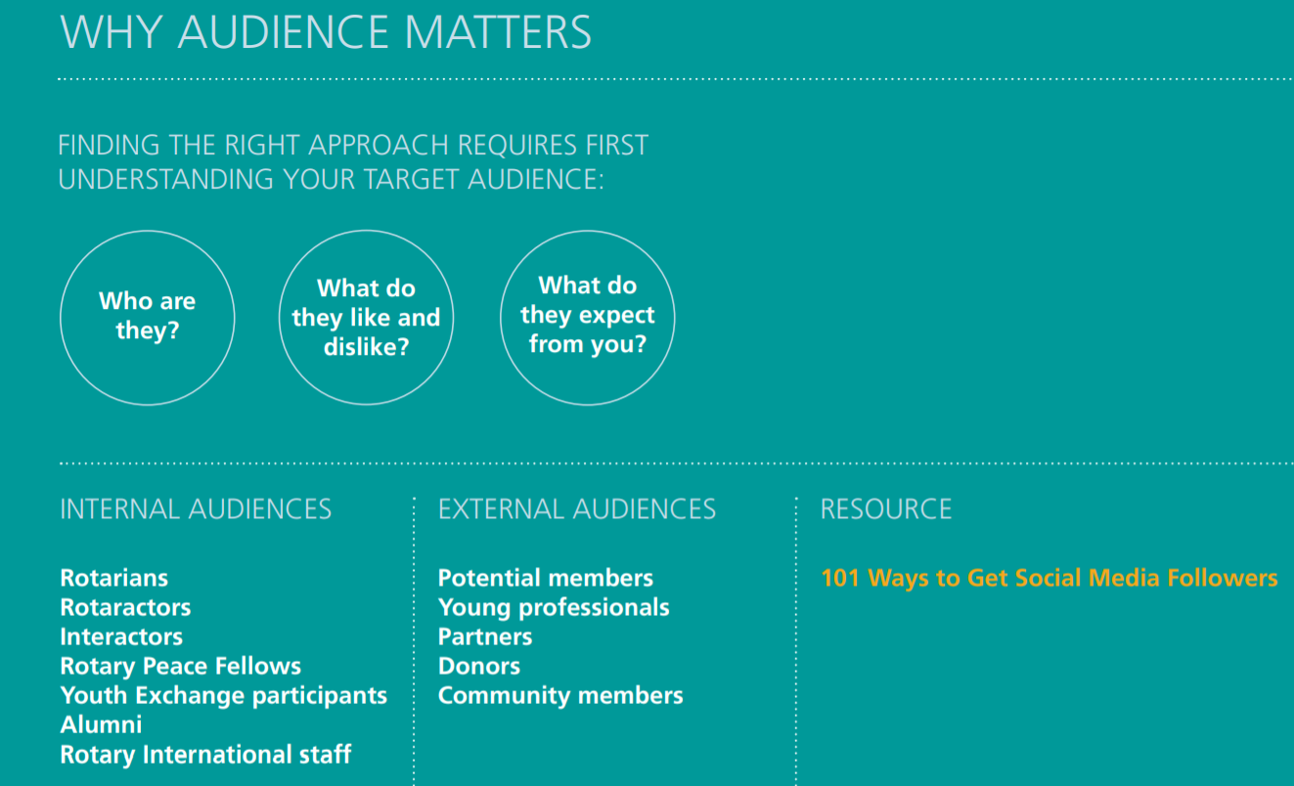
Internal and external audiences… basically a lot of friends
ROTARY QUICK START GUIDE FOR CLUB SOCIAL MEDIA PAGES

Slide 6

Step 1: set goals and objectives
Identify the objectives you want your club to achieve through Facebook and set goals that will mark your progress. Keep your goals specific and measureable.
EXAMPLE OBJECTIVE
Increasing fans and followers
SAMPLE GOAL
Increase followers by 5% from the previous year
Create Facebook events for upcoming club meetings and invite prospective members
ROTARY QUICK START GUIDE FOR CLUB SOCIAL MEDIA PAGES
Notes:
SAMPLE GOALS
Invite email contacts and Facebook friends to like my club page
Add a Donate button to my club’s Facebook page to promote our fundraising efforts
Calculate how many donations my page gets through Facebook

Slide 7
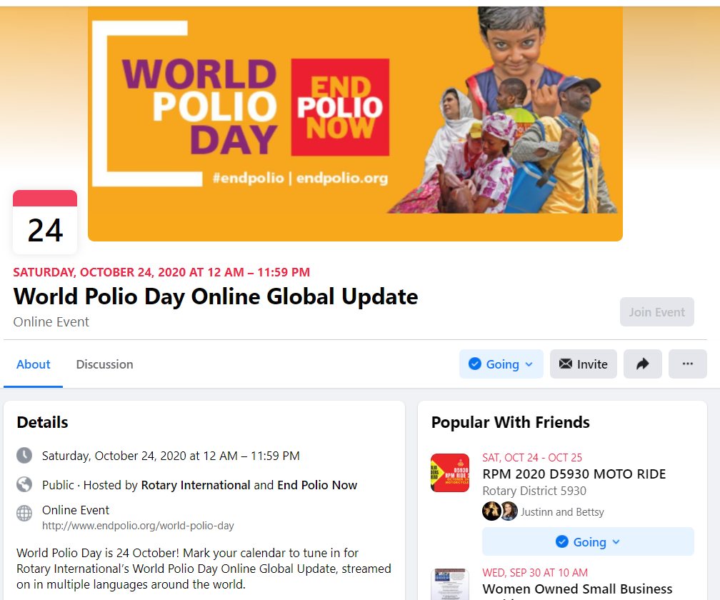
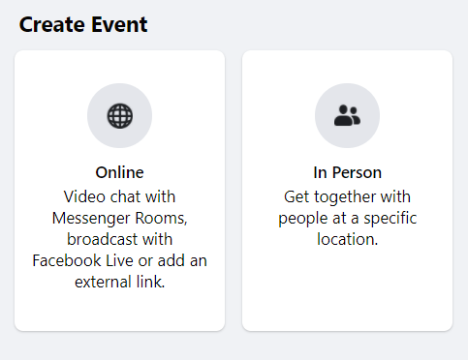
Facebook events
A “FRIENDLY” REMINDER
Go To Your Club’s Page
Click On Events
Click Create Event
Click Event Type;
Fill In The Event Name, Location, Date, Time and Description.
Use Key Words to Describe Your Event
Choose Who Can Edit or Post With The Event

Slide 8
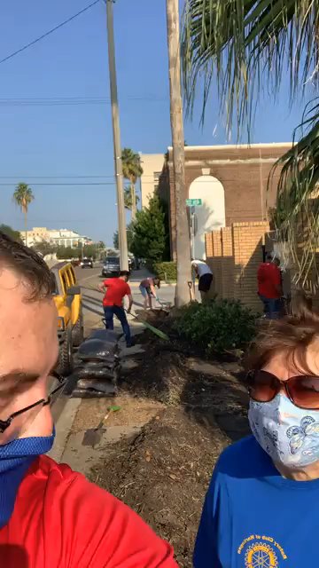
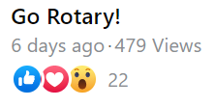
CREATING CONTENT TO SHARE: VIDEOS
Rotary Club of Harlingen Texas
“Today’s technology makes it easy to tell your story through video. Take a behind-the-scenes video at your next event or record a series of interviews that feature club members and partners in your community.” - RI
“Does it help tell the People of Action story, Rotary’s new public image campaign? The content should make the reader want to learn more about your club and Rotary.” - RI
Notes:
NEED LINK TO VIDEO AND NEED A SECOND VIDEO

Slide 9
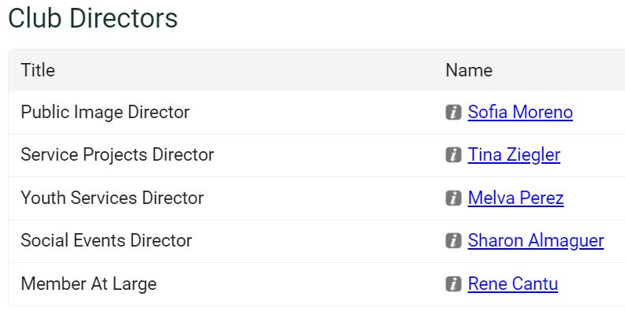
YOUR FACEBOOK PAGE NEEDS A BFF… a public image director & team!!
HOW OFTEN SHOULD YOU POST ON SOCIAL MEDIA?
3-4 original posts per week. Share an interesting or inspiring post from someone else every other day.
“Plan for one hour daily to:
  Find and post content
  Monitor your pages for questions and comments
  Connect with fans and followers online (reply, like, and share relevant posts)”
Rotary District 5930 & ROTARY QUICK START GUIDE FOR CLUB SOCIAL MEDIA PAGES

Slide 10
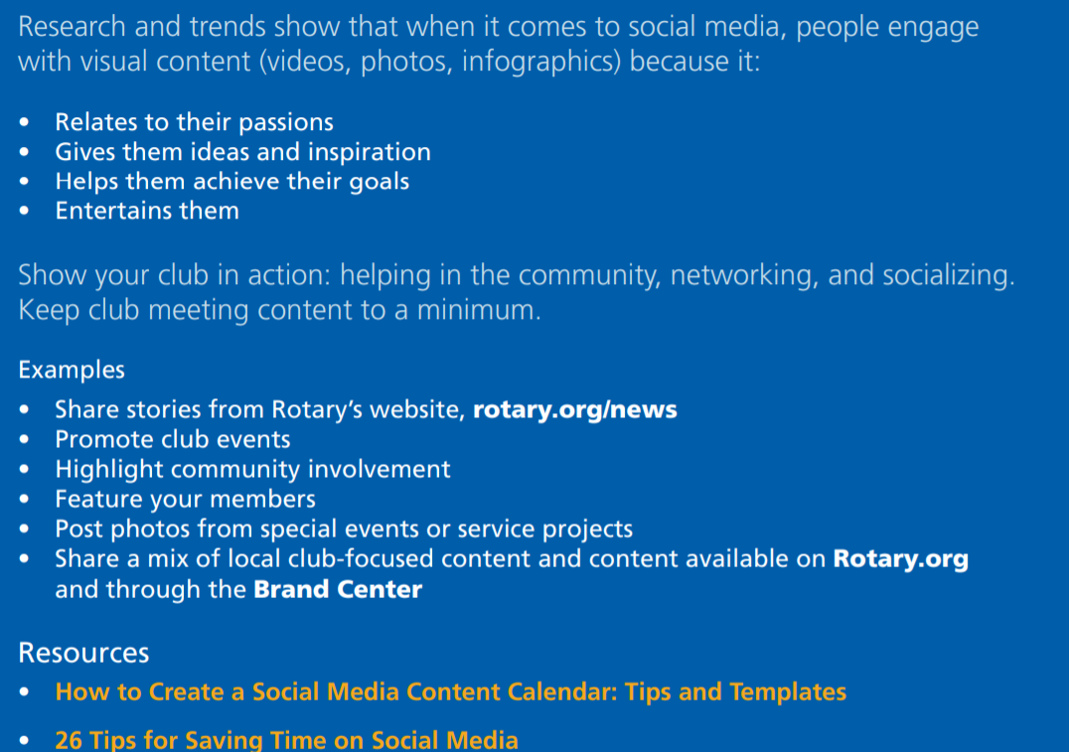
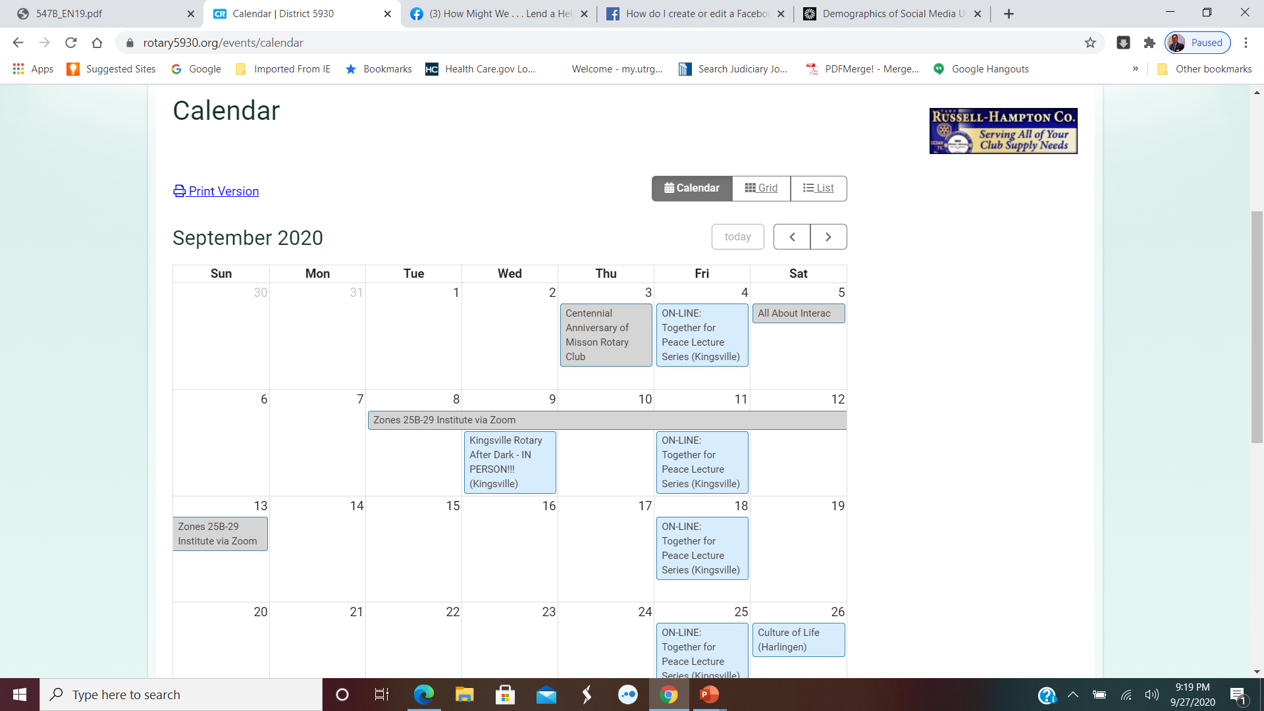
Creating your content plan
Rotary District 5930 & ROTARY QUICK START GUIDE FOR CLUB SOCIAL MEDIA PAGES

Slide 11
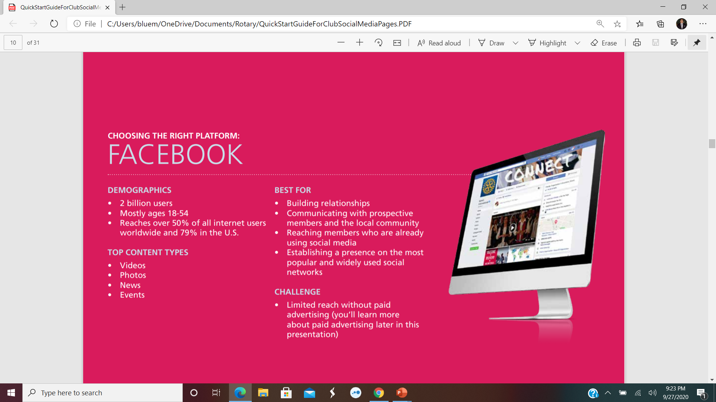
11
SO, WHO IS YOUR FRIEND? FACEBOOK!
ROTARY QUICK START GUIDE FOR CLUB SOCIAL MEDIA PAGES

Slide 12
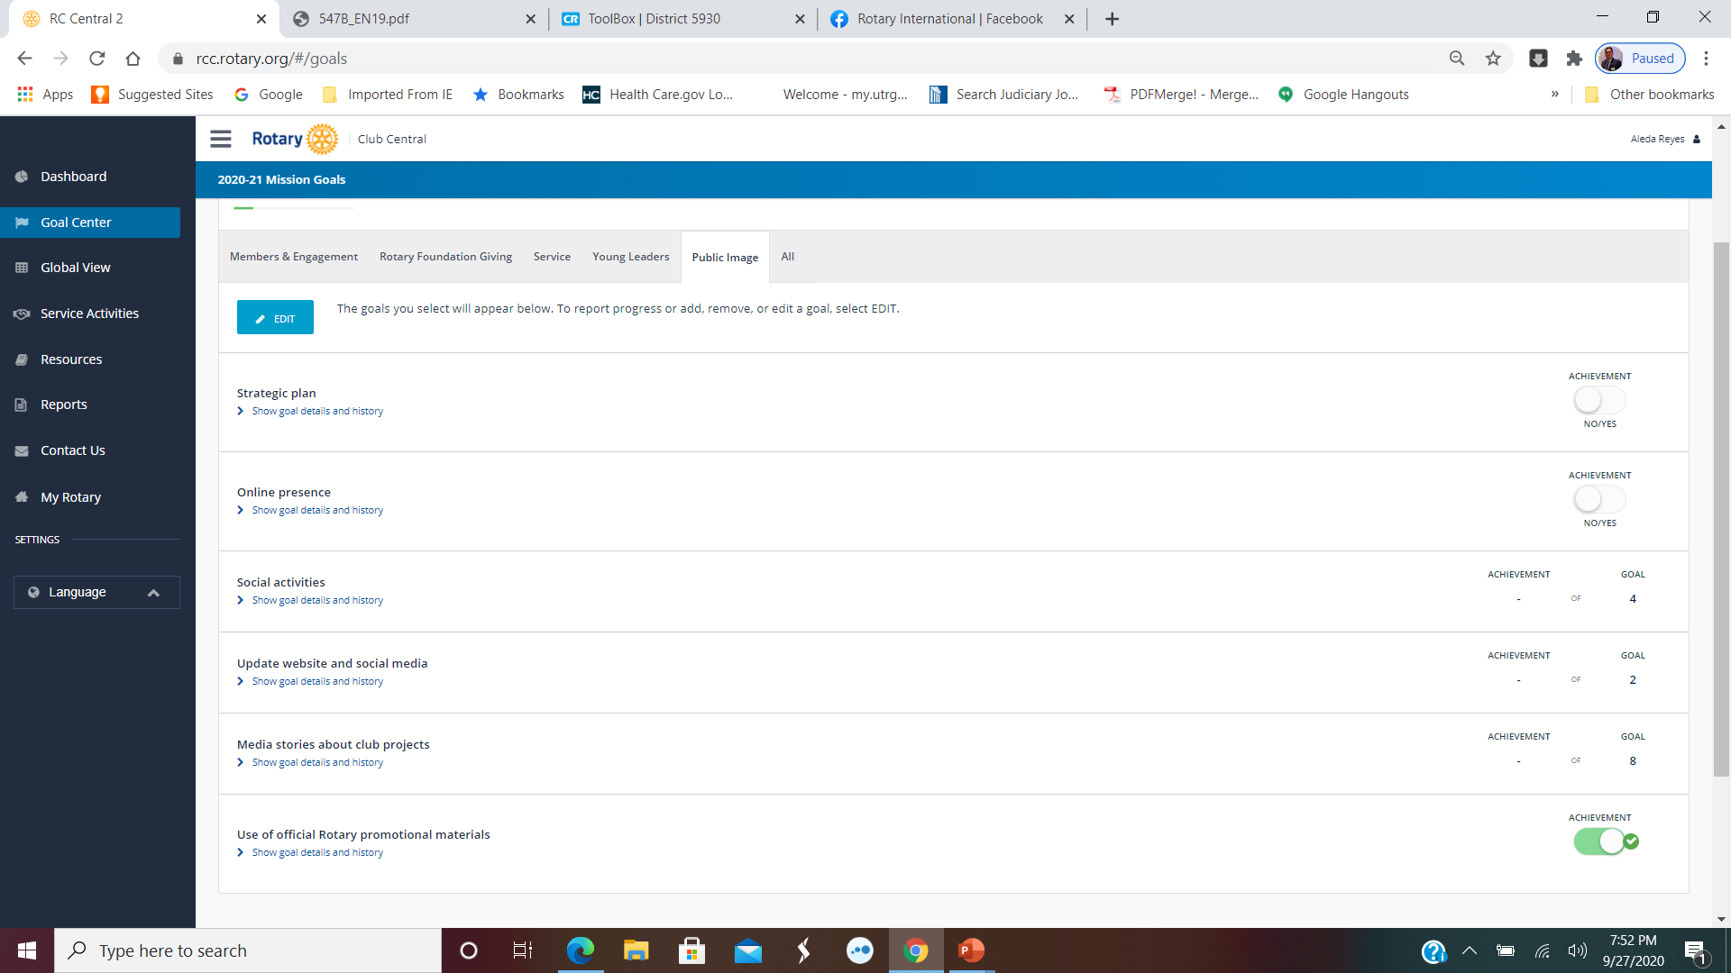
Rotary club central: goal center
Notes:
Communicate with your board to help your club by setting and following goals for Public Image.

Slide 13
QUESTIONS

Slide 14
RESOURCES:
ROTARY DISTRICT 5930
PEW RESEARCH CENTER
HARLINGEN ROTARY CLUB
ROTARY INTERNATIONAL
ROTARY QUICK START GUIDE FOR CLUB SOCIAL MEDIA PAGES
FACEBOOK

Slide 15
Rotary Public Image and Awareness Team
Orlando Hernandez, Rotary Club of Los Fresnos
Juanita Stringfield, Rotary Club of Harlingen
Catherine H. Whatley, Rotary Club of Corpus Christi Evening
Charlie Whatley, Rotary Club of Corpus Christi Evening
Justinn Jones, Rotary Club of Kingsville
Aleda J. Reyes, Rotary Club of Mission
www.rotary5930.org

