Slide 1
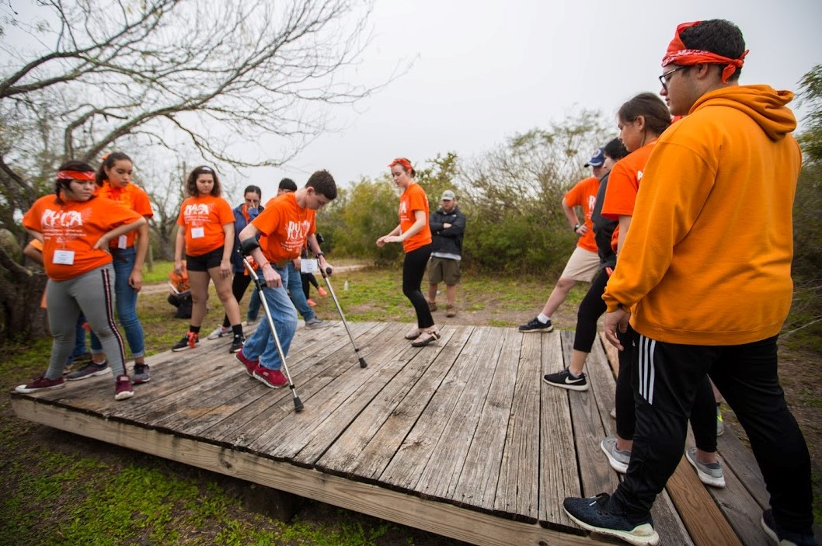
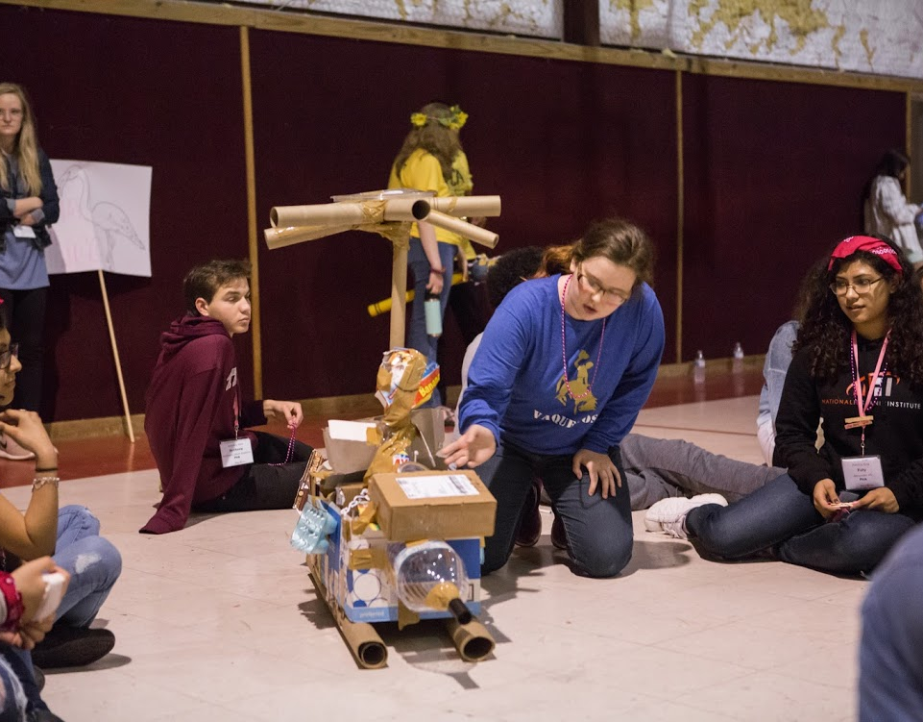

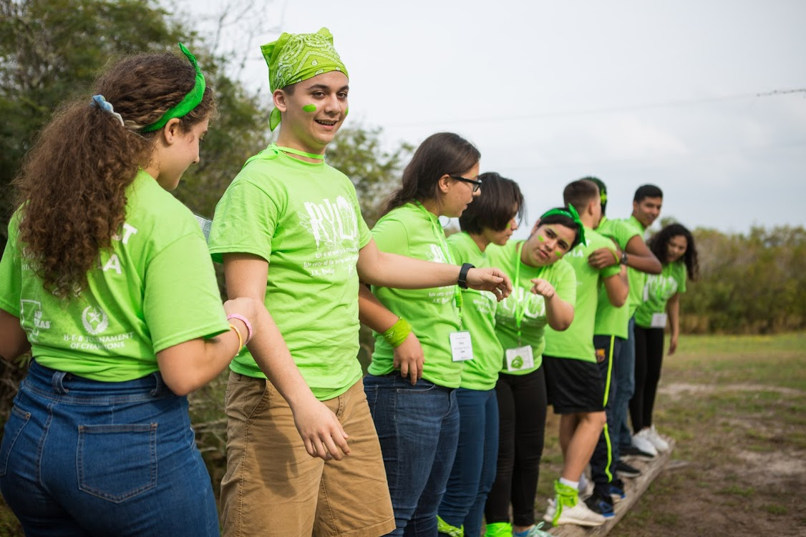
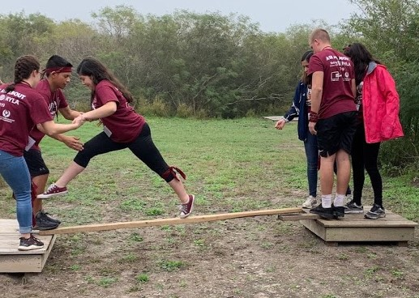
eRYLA
District 5930
March 11-14, 2021

Slide 2
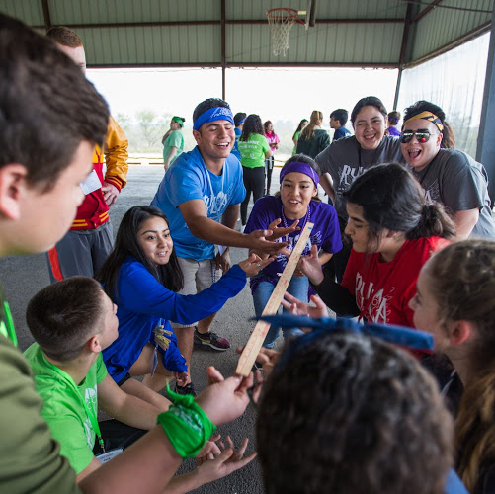
What is eRYLA?
Leadership Camp for HS school sophomores & juniors
Experiential programming developed by professional youth educators of Leader NU, LLC
Fun, challenging, hands-on team learning experience based on the in-person camp

Slide 3
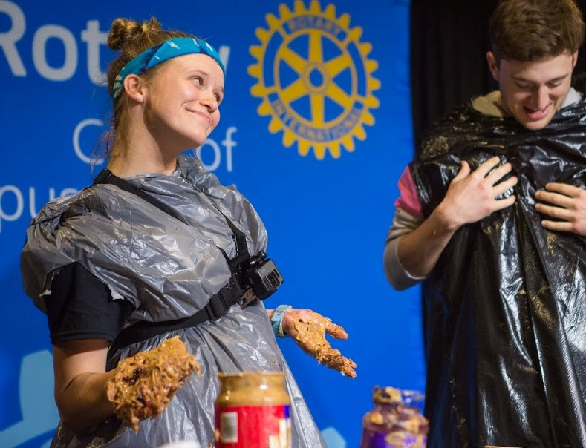
What is eRYLA?
Pathway to advanced Rotary - sponsored youth leadership training
Campers sponsored by District 5930 Rotary Clubs
Organized by the Rotary Club of Corpus Christi
Interactive virtual delivery via Zoom

Slide 4
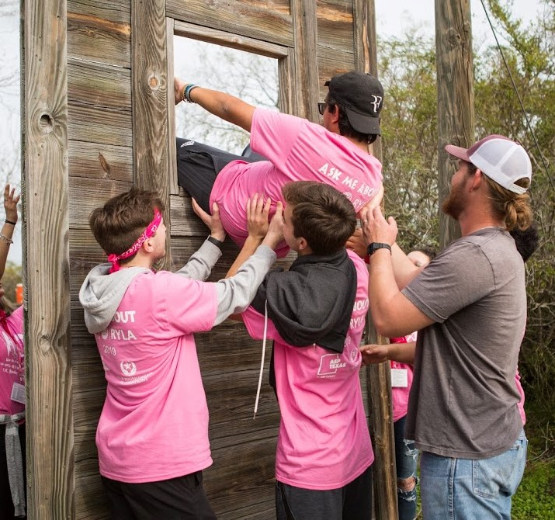
How is eRYLA different than RYLA?
Virtual Camp – all interaction via ZOOM
Timing – no conflict with school day – evenings and weekends only
All camp materials, T-shirt, etc. are shipped to camper’s home
Prospective campers apply on-line, one page form

Slide 5
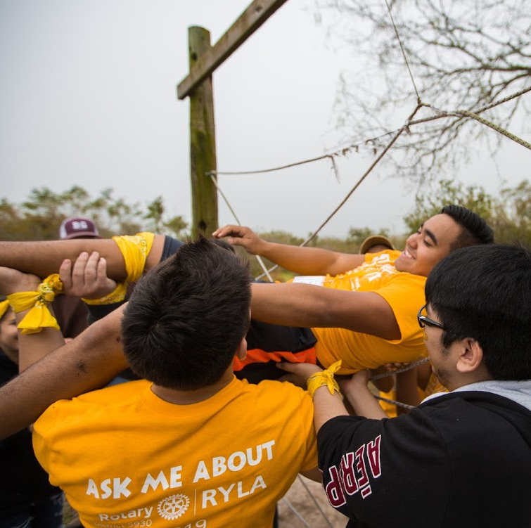
How is eRYLA different than RYLA?
Clubs direct prospective campers to the on-line application site
No packet of application papers to gather, exchange, submit (yeah!)
Clubs can review applications or let Rotary Club of Corpus Christi screen applications and notify clubs of qualified applicants

Slide 6
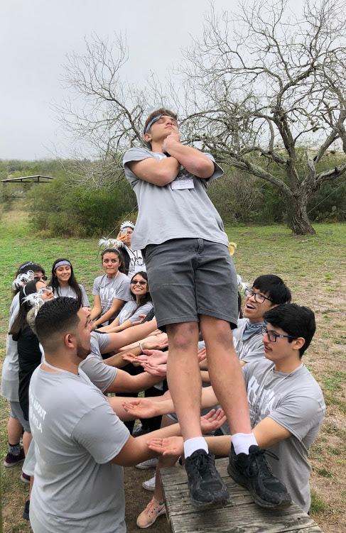
eRYLA: when, how?
When: Thursday, Friday evening, Saturday, half Sunday, March 11-14,2021
How: Campers MUST have computer (laptop or desktop with microphone & camera)and internet access (smartphones are not sufficient)
How: Campers MUST commit to full camp participation

Slide 7
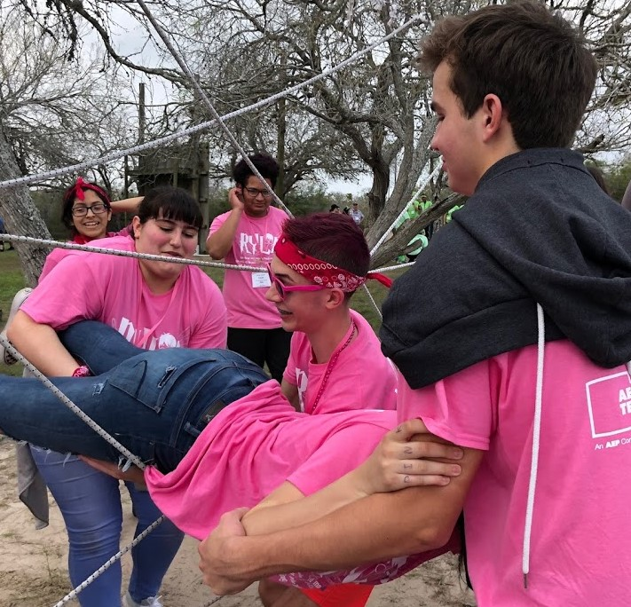
eRYLA: when, how?
How: Clubs must pay for sponsored applicants by deadlines
  $300 through December 18,2020
  $325 December 19- February 5, 2021
  No applications after February 5, 2021
  *Camp costs shift to technology & virtual programming (professional ZOOM license, materials shipping and professional programming/staffing provided by Leader NU LLC)
How: http://www.rotarycc.com/youth-service/ryla/eryla-forms-library/

Slide 8
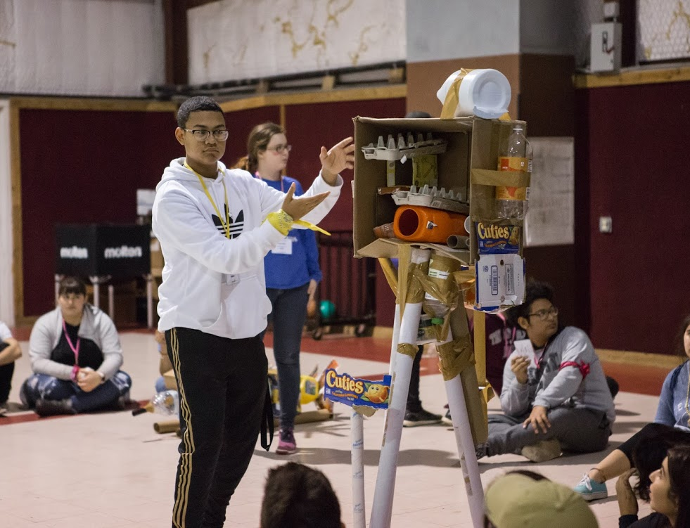
eRYLA: Action items for clubs
Now: send name, email, phone of your club contact for eRYLA to Christine.Wisian@gmail.com or 361-779-6190
Now: outreach to identify qualified applicants - Interact Clubs; school counselors, Rotarians
Now: provide link to all qualified applicants at https://www.ismyrotaryclub.org/Ryla/?ID=31

Slide 9
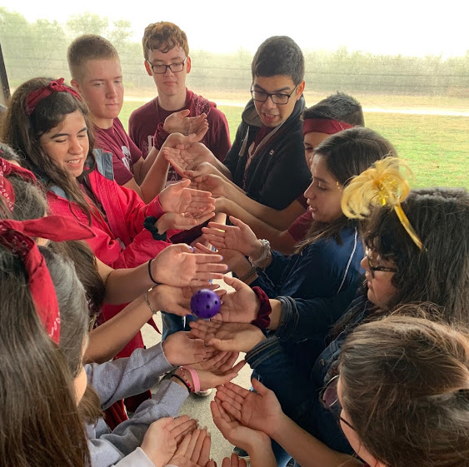
eRYLA: Action items for clubs
Select applicants your club will sponsor
  Review applications submitted by students OR
  Allow Rotary Club of CC to select from qualified applications
Submit your payment by deadline to Rotary Club of Corpus Christi
Follow up with your campers to assure participation

Slide 10
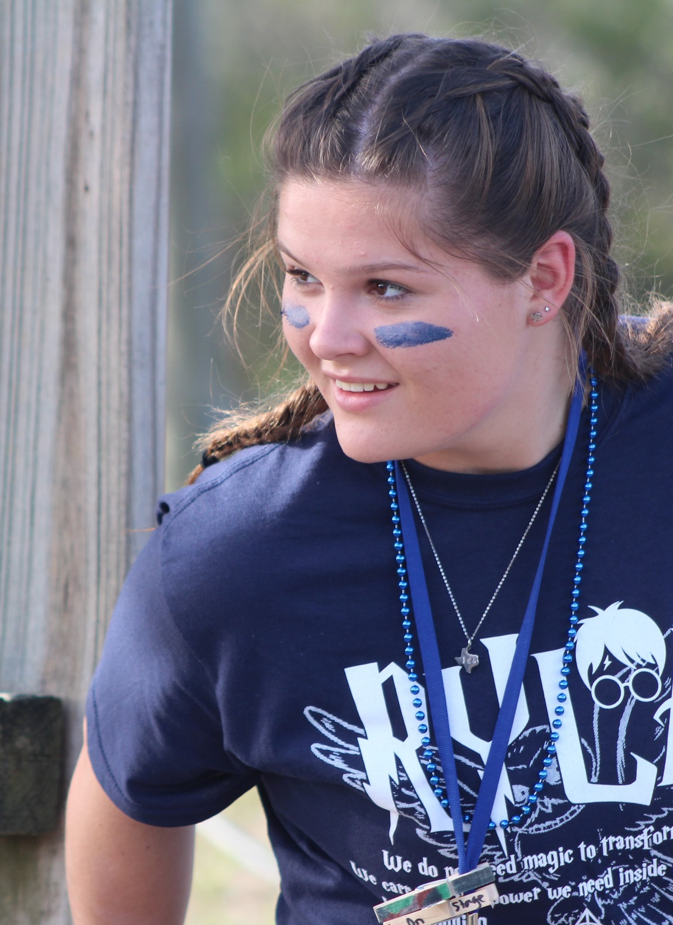
eRYLA Proven Success
Programming for District 5930 is provided by Leader NU
Bridget Markwood is a Rotarian, formerly of Corpus Christi
Bridget has run Camp RYLA for Oklahoma District 5750 for 21 years
Corpus Christi and Oklahoma RYLA programs have shared programming and leadership for several years
Leader NU adapted RYLA to a virtual format for their 2020 camp with great success

Slide 11

eRYLA: Camper Comments
How eRYLA campers answered: Did the virtual leadership camp have an impact? Was it successful?
"RYLA has definitely achieved that, and then some.”
"I did an eRyla this summer and it helped me a lot with my leadership skills and my confidence and I just would recommend it to anyone who needs a family or needs leadership skills.“
"I too was skeptical at first but this camp has truly changed my life for the better. This camp already means so much to me and this year I was just a camper. Being a part of this showed me so much kindness I needed in my life and how truly amazing people can be."

Slide 12
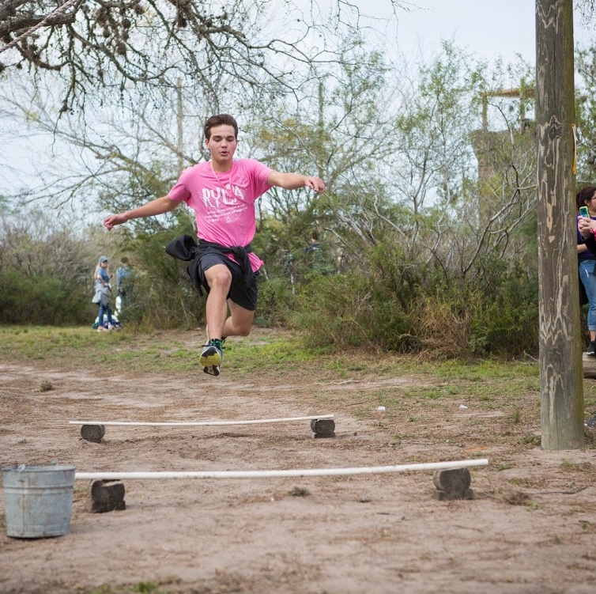
eRYLA: Action items for clubs
Check out Leader NU website for target outcomes
www.leadernu.com/ryla/info

