Slide 1




Slide 2

Rotary International, The Rotary Foundation, & District 5930
Rotary’s Vision for the Future
Together, we see a world where PEOPLE unite and take action to CREATE lasting CHANGE across the globe, in our communities, and in ourselves.
Mission of The Rotary Foundation (TRF) (How can TRF contribute to achieving the vision?)
The mission of The Rotary Foundation of Rotary International is to enable Rotarians to advance world understanding, goodwill, and peace through the improvement of health, the support of education, and the alleviation of poverty.
https://cdn2.webdamdb.com/md_2s5aBUiZL731.mp4?1598896734 The Rotary Foundation

Slide 3

District Rotary Foundation Team (DRFT)
Purpose of the Team: To help each other engage Rotarians and other entities in efforts to help The Rotary Foundation advance world understanding, goodwill, and peace through the improvement of health, support of education, and alleviation of poverty.
Vision for the Team: District 5930 encourages clubs to donate to The Rotary Foundation’s Annual Fund to help advance world understanding, goodwill, and peace through the improvement of health, support of education and alleviation of poverty, and engage in activities to address these issues. Among these activities are those aligned with The Rotary Foundation’s Areas of Focus, i.e., Peacebuilding and Conflict Prevention; Disease Prevention and Treatment; Water, Sanitation, and Hygiene; Maternal and Child Health; Education and Literacy; Community Economic Development; and Supporting the Environment.

Slide 4
Vision for the Team (contd)
We envision clubs operating in accordance with the Object of Rotary. That is, clubs are urged to foster the ideal of service as a basis of worthy enterprise by encouraging and fostering:
First: The development of acquaintance as an opportunity for service;
Second: High ethical standards in business and professions; the recognition of the worthiness of all useful occupations; and, the dignifying of each Rotarian’s occupation as an opportunity to serve society;
Third: The application of the ideal of service in each Rotarian’s personal, business, and community life;
Fourth: The advancement of international understanding, goodwill, and peace through a world fellowship of business and professional persons united in the ideal of service.

Slide 5
District Rotary Foundation Team Mission
(How will our Team help clubs?)
The DRFT is committed to informing Rotary clubs about the TRF, its purpose, services, and impact; guiding clubs in their efforts to support TRF Annual Fund; and, facilitating clubs’ efforts to become engaged in activities supported by The Rotary Foundation.

Slide 6
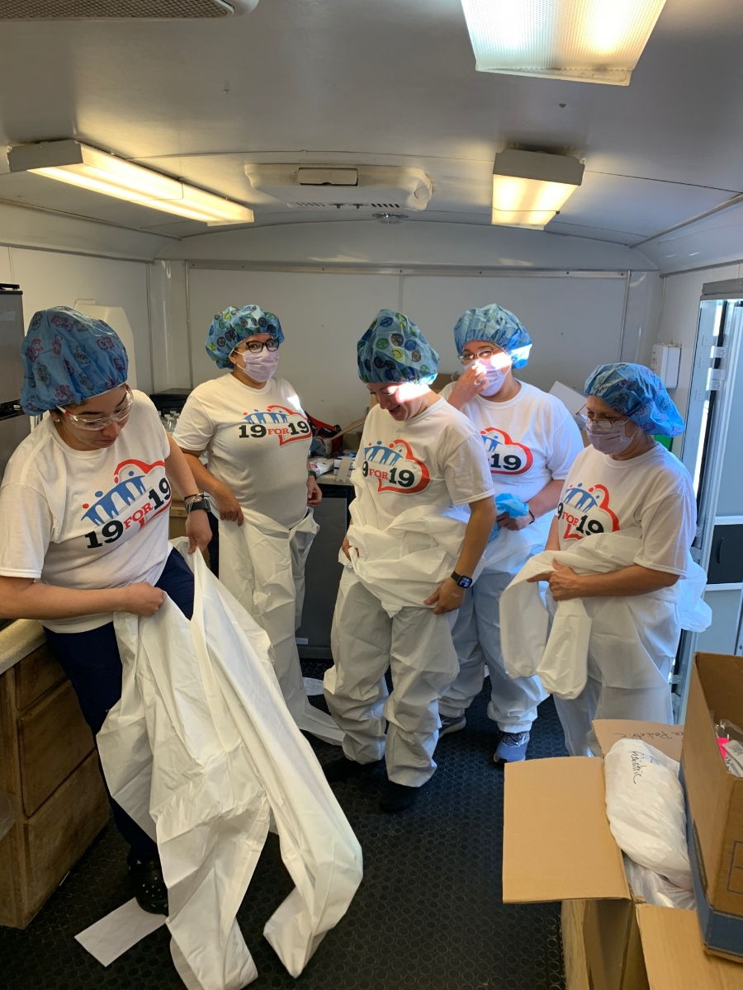
IMPACT OF THE ROTARY FOUNDATION
COVID 19 DISTRICT GRANT
ALICE ROTARY CLUB
PERSONAL PROTECTIVE EQUIPMENT FOR HALO FLIGHT STAFF

Slide 7
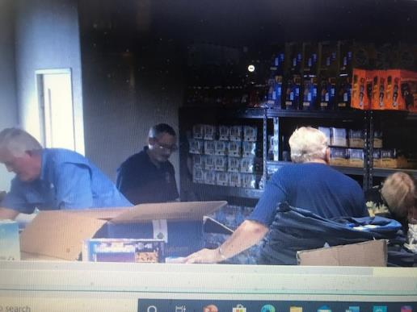
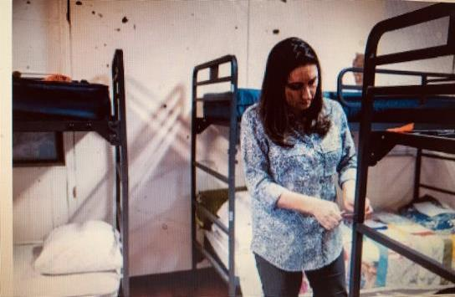
The Rotary Foundation
Making a Difference - District Grants
West Corpus Christi Rotary Club
Bunk Bed Project
Harlingen Sunburst Rotary Club
Food Backpacks for Kids

Slide 8
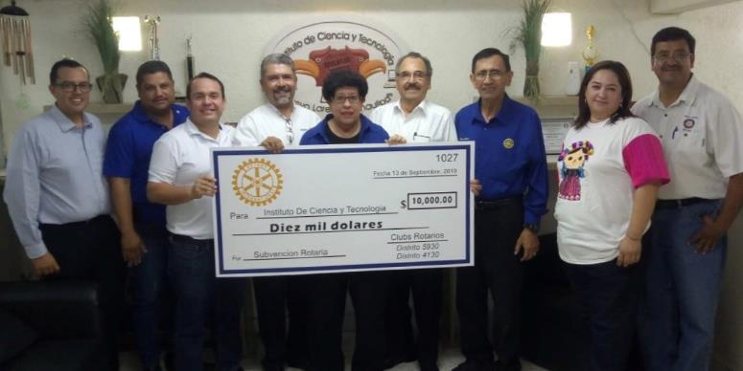

International District Grant
Initiated by The Laredo Rotary Club, other clubs, & D5930
Instituto de Ciencia y Tecnología, a middle school in Mexico
https://youtu.be/L0jNXNId8NQ Video made by the school showing materials purchased.

Slide 9

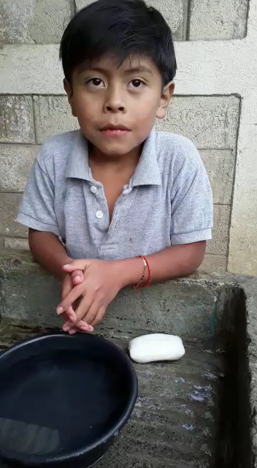
GLOBAL GRANT # 1862702 ($70,036)
CORPUS CHRISTI ROTARY CLUB, LOS ALTOS ROTARY CLUB, DISTRICTS 4250 AND 5930, OTHER PARTNERS, AND THE ROTARY FOUNDATION PROVIDED GUIDES TO GUATEMALAN SCHOOLS TO HELP STUDENTS LEARN STRATEGIES TO HELP PREVENT COVID 19.

Slide 10
COSTA RICA INTERNATIONAL OPPORTUNITY SCHOLARSHIP
College/University students selected (Costa Rica Scholars) spend two weeks as volunteer members of a Medical Brigade in Costa Rica working under the supervision of medical professionals.
Scholars help provide medical services to individuals in need.
Interactions with community members and other brigade members help Scholars recognize the positive difference they are making.
The video in the next slide provides a glimpse of the experiences encountered by Paula Villalpando and Humberto Garza (District 5930 Costa Rica Scholars, May 26-June 8, 2019).

Slide 11
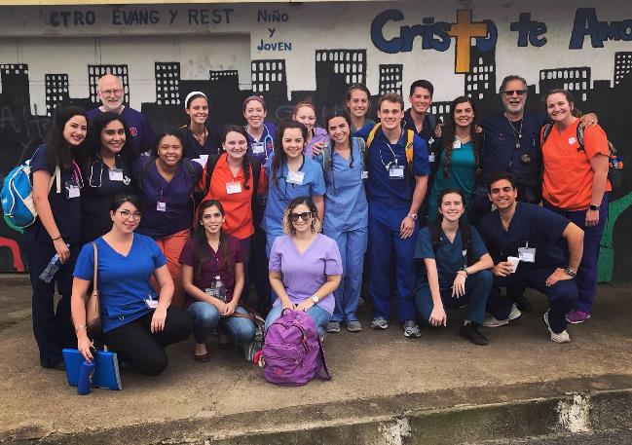
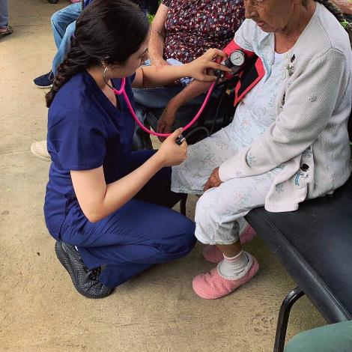
https://youtu.be/xMSbGEf3laI Video shows Costa Rica Scholars at work and having fun.

Slide 12
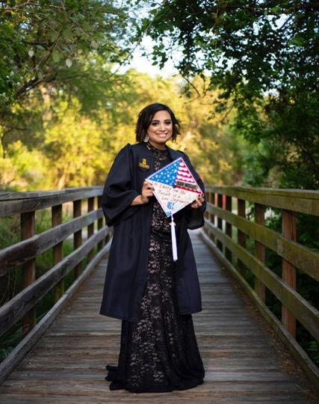
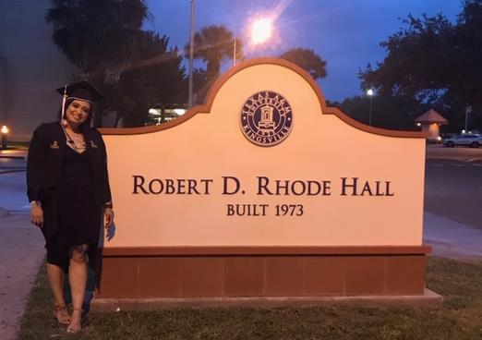
Military Veteran Scholarship Recipient
Samantha San Miguel, B.A., Texas A&M University - Kingsville

Slide 13
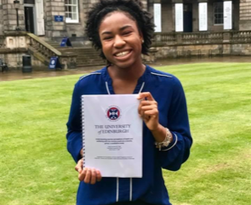
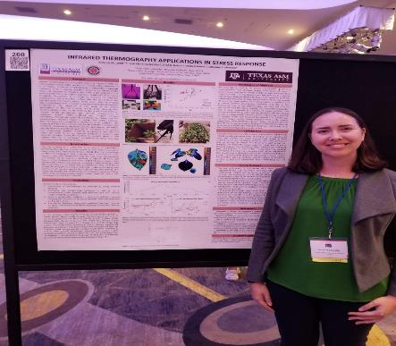
Global Grant Scholarships
Global Scholar Kayla Stovall
M. S. Univ. of Edingburgh, Scotland
Global Scholar Amanda Lewis
M.S. Wageningen Univ., The Netherlands

Slide 14
Background of The Rotary Foundation (TRF)
1917: TRF began with an initial donation of $26.50.
RI President Arch Klump: Decided to use funds to do good in the world.
2020: Donations are now $1,127,298,300.
2016: Named the World’s Outstanding Foundation by the Association of Fundraising Professionals
Named a Four-Star Charity with a perfect 100 overall score by Charity Navigator (Less than 1% of charities earn a perfect score.)
TRF: Is a 501 C 3: Contributions are tax deductible
Link below illustrates grants supported by donations to The Rotary Foundation.
https://infogram.com/rotary-foundation-grants-1hzj4o57qxop2pw

Slide 15

Special Funds Supported by TRF
  Annual Fund – SHARE System for local and International grant projects
  Annual Fund – Approved Global Grant addressing an Area of Focus
  Peacebuilding & Conflict Prevention Maternal & Child Health
  Disease Prevention & Treatment Education & Literacy
  Water, Sanitation, & Hygiene Community Economic Development
  Supporting the Environment
  Disaster Response Fund
  PolioPlus
  Endowment Fund

Slide 16
Annual Fund & SHARE System
Annual donations to TRF are invested for 3 years.
Earnings accumulated are then divided into two pots.
50% goes to TRF World Fund to support global grants.
Other 50%: returned to D5930 in District Designated Funds (DDF)
Half of DDF: Supports global grants & Global Grant Scholarships
Other half of DDF: Supports District Grants, payment for Clubrunner module, Costa Rica International Scholarships, and Military Veterans Scholarships.

Slide 17
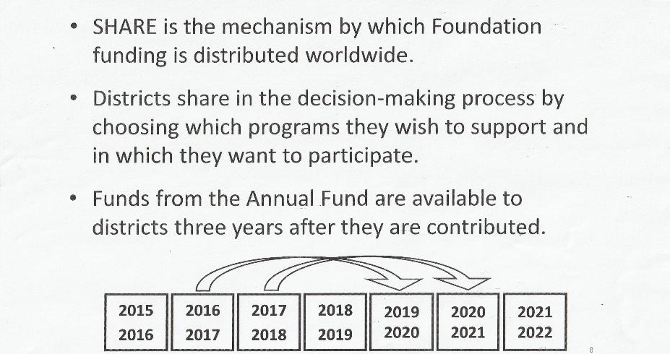
THE SHARE SYSTEM

Slide 18

Recognition of Rotarians Who Contribute to Annual Fund
Every Rotarian Every Year (EREY)
Every Rotarian Every Year (EREY) (requires $25 or more / year)
EREY seeks to engage every Rotarian in this life-changing program of TRF by encouraging them to:
Get involved in a RF project or program every year
Contribute to the Annual Fund on a regular basis

Slide 19

Rotarian Recognition: Sustaining Member ($100 per year)
Contributes $100 or more each year to Annual Fund.
Equals to:
$25.00 per quarter
$8.33 per month
$1.92 per week
$0.27 per day

Slide 20

Ways to Give – Rotary Direct – Recurring Giving
Select a designation, amount, and frequency
Three ways to enroll:
  On-line at www.rotary.org/give (confirm you’re logged in before selecting Donate)
  By mail: Use enrollment form
  By phone: 1-866-976-8279
  Minimum Contribution:
  $10/transaction -- $10/month; $10/quarter; $10/year
  Credit Card only

Slide 21


Examples of What a Sustaining Contribution of $100 Can Do
Provide three cataract surgeries in India
Buy 15 backpacks of teaching materials for a school in Costa Rica
Feed a family in India or Pakistan for six months
Bring clean water to 600 school children in Africa
Buy two desks for an elementary school in Honduras
Supply 50 mosquito nets for women and children in Tanzania

Slide 22

Paul Harris Society Member ($1,000 per year)
Rotarian contributes $1,000 or more each year to Annual Fund
Designation recognizes Rotarians who have the ability and desire to make substantial annual gifts to help communities in need around the world.
Recognizes donor as a Paul Harris Fellow (PHF) with a pin & certificate.
Donor may earn multiple PHF designations
$1,000 Donation equals to:
$250.00 per quarter $83.33 per moth
$19.20 per week $2.70 per day

Slide 23
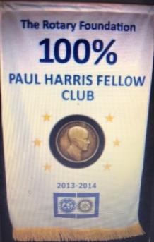
TRF Recognition for Clubs
100% Rotary Foundation Giving Club Banner
Earned by clubs that achieve a $100 per capita and every dues paying member personally contributes $25 or more to one or more of the following: Annual Fund, PolioPlus, Disaster Response Fund, Endowment Fund, or to an approved global grant during the Rotary year.
Based on membership as of June 30th;
members who join the club after July 1
will not count in this computation.

Slide 24
Endowment Fund
Endowment Fund donations often are major outright gifts, bequests, or life-income agreements.
Contributions to the Endowment Fund are invested to preserve and increase the principal.
Each year, part of the earnings supports grants and programs.
Important to work closely with the District Rotary Foundation Chair, Rotary Foundation Coordinator, Endowment/Major Gifts Advisor, and Foundation staff to make proper arrangements for the endowment.

Slide 25
PolioPlus Fund
PolioPlus contributions are used solely for achieving the worldwide eradication of polio.
District PolioPlus initiatives are coordinated by Jo Anne Settles (joanne.settles@victoriacollege.edu)
District 5930 Polio MotoRun is intended to raise funds for the PolioPlus Fund.
Contact person for Polio MotoRun is Mike Dickerson (jmd@dickersonlaw.com)

Slide 26
Disaster Response Fund
Established by The Rotary Foundation through the generous donations of Rotarians and other concerned individuals to help communities facing disasters recover.
Qualified districts can apply for Disaster Response Grants to support relief and recovery efforts in areas that have been affected by natural disasters within the past 6 months.
Grants are awarded to districts located in the affected area only.
Grant funds can be used to provide basic items such as water, food, medicine, and clothing.

Slide 27
What You as a Rotary Club Leader Can Do to Support
The Rotary Foundation
Have a Foundation minute at designated club meetings
Encourage members to support the Rotarian, Every Year campaign
Share examples of why it makes sense to donate
Make it easy for members to donate:
Rotary Direct
On-line credit card contributions
Add voluntary contribution amounts to dues invoices
Make regular “asks” during the year, e.g., November (Foundation Month)

Slide 28

November is Foundation Month!
Plan some activities! (suggestions in the next slide).

Slide 29
Suggestions for Moving Forward
Engage club members in a brain-storming session about ways to raise funds for TRF.
Funds from special events could be earmarked for TRF.
EXAMPLES:
Fishing Tournament (while maintaining social distancing): Participants pay a fee to participate; prizes for different categories (e.g., largest fish, smallest fish, etc.) could be donated. Funds generated will be donated to TRF.
Virtual Public Health Event: Use a social media campaign to help organize a virtual event intended to raise funds to purchase Personal Protective Equipment (PPE) for first-responders. Show video clips of how TRF is impacting people and communities locally and beyond. Funds raised will be donated to TRF, invested, and then a portion will be returned to District 5930 to help support district grant applications from clubs. Your Rotary club can submit a district grant application to purchase PPE for first responders.
Multiplier Effect of Donations to TRF: Club donations can be leveraged. For example, a $1000 club donation could be complemented by a $4,000 District contribution and an additional $5,000 from other Rotary clubs and other entities to purchase PPE valued at $10,000.

Slide 30

Reflection
The Rotary Foundation is not to build monuments of brick and stone.
If we work upon marble, it will perish;
If we work on brass, time will efface it;
If we rear temples, they will crumble into dust;
But, if we work upon immortal minds …,
We are engraving on those tablets something that will brighten all eternity.
            -- Arch C. Klumph (Father of The Rotary Foundation)
            December 1928

Slide 31

THANK YOU!!
For additional Information, contact the District Rotary Foundation Team
Maxie Houser, Chair maxiehouser@gmail.com
Eddie Bartnesky eddie@rotary5930.com
Amando Chapa mandochapa@msn.com
Kent Grier kent.grier@sbcglobal.net
Ellison Crider ellisoncrider@gmail.com
Dee Arismendez deedeerotary@gmail.com
Kimberly Harrington kharrington1@farmersagent.com
Jerry Spence jspence@gowland-cpa.com
Haysam Dawod haysamdawoddds@gmail.com
Lisa Rogerio lrogerio@webbcountytx.gov
Betty Frantum b.frantum233@gmail.com
Joanne Settles joanne.settles@victoriacollege.edu
Mike Dickerson jmd@dickersonlaw.com
Sara Pompa sara.pompa@laredo.edu
Nianna Gustovich ngustovich@gmail.com
Elaine Hernandez ehernandez2125@gmail.com
Nancy Paulson nancy@rockportwebsites.com
Juan Lira juanliratx@aol.com

